Slide 1
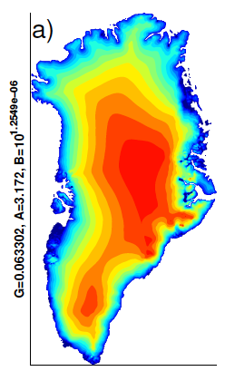
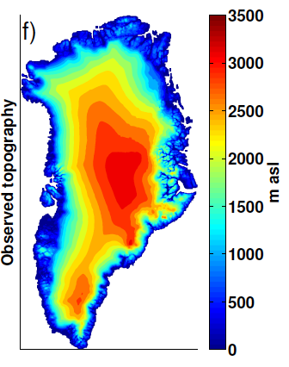
Dynamic ice sheets in the Community Earth System Model
Objective
Implement and evaluate the Glimmer Community Ice Sheet Model (Glimmer-CISM) in the Community Earth System Model (CESM) as a first step toward fully coupled ice-sheet/climate modeling.
Research
Implemented Glimmer-CISM in CESM
Ice sheet surface mass balance (SMB) computed in Community Land Model
SMB downscaled to Greenland grid, applied to dynamic ice sheet model
Ran Greenland Ice Sheet to equilibrium in an ensemble of 100 parameter sets
Chose optimal parameter sets and ran model from 1850-2100 to estimate Greenland contribution to sea-level rise
Greenland ice sheet topography: (left) simulated in CESM by optimal ensemble member; (right) observed.
Impact
First use of a global climate model to generate a realistic surface mass balance for forcing a dynamic ice sheet model
Found that reduced ice discharge partly offsets increased melting
Identified positive SMB bias along northern Greenland coast
Reference: Lipscomb, W.H., J. G. Fyke, M. Vizcaíno, W. J. Sacks, J. Wolfe, M. Vertenstein, T. Craig, E. Kluzek, and D. M. Lawrence (2013), Implementation and initial evaluation of the Glimmer Community Ice Sheet Model in the Community Earth System Model, J. Climate, doi:10.1175/JCLI-D-12-00557.1.
Notes:
Wanda says that this is a general slide with no specific reference

