Slide 1
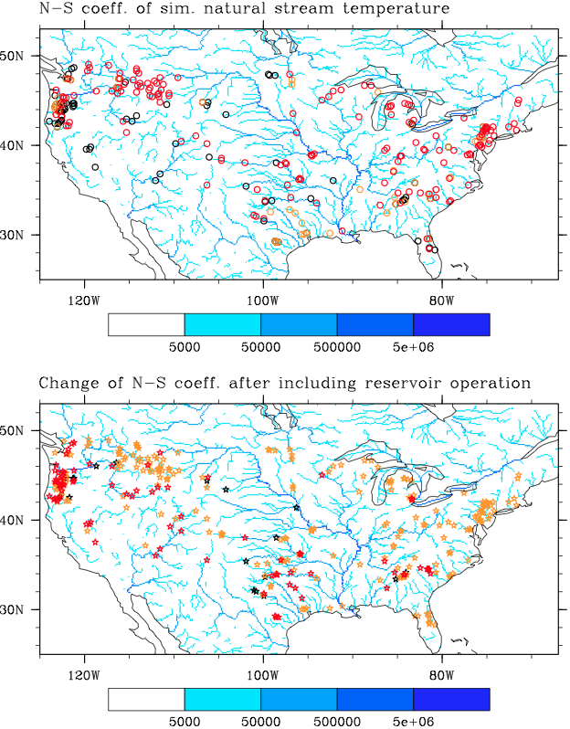

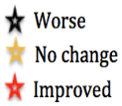
Modeling Stream Temperature in the Anthropocene:
An Earth System Modeling Approach
Objective
Develop a new stream temperature module in the Model for Scale Adaptive River Transport (MOSART) coupled with the Community Land Model (CLM) and a water management model
Evaluate the model performance over the contiguous United States
Approach
Estimate headwater temperature based on CLM soil thermodynamics and runoff
Represent advective heat transport and water-atmosphere heat exchanges in MOSART
Represent reservoir regulation effects based on a generic water management module
Evaluate model simulation against observations at 321 USGS gages
Investigate the impacts of water management on stream temperature
Comparison of observed and simulated daily stream temperature over 321 USGS stations in 2001-2010. Top: Nash-Sutcliffe (N-S) coefficient for values < 0.0 (black), between 0.0 and 0.5 (golden), and > 0.5 (red). Bottom: Change in the N-S coefficient values by including water management in the model simulation. Black, golden, and red stars indicate decrease, no change, and increase in model skill as measured by the change in the N-S values at 0.05 significance level.
Impact
First stream temperature model in an Earth system modeling framework and with explicit representation of reservoir operation effects
Provides a foundation to represent terrestrial-aquatic interactions and water-energy nexus
Li H-Y, L Ruby Leung, T Tesfa, N Voisin, M Hejazi, L Liu, Y Liu, J Rice, H Wu, and X Yang. 2015. “Modeling Stream Temperature in the Anthropocene: An Earth System Modeling Approach.” Journal of Advances in Modeling Earth Systems 7. DOI: 10.1002/2015MS000471
Notes:
http://www.pnnl.gov/science/highlights/highlights.asp?division=749

