Slide 1
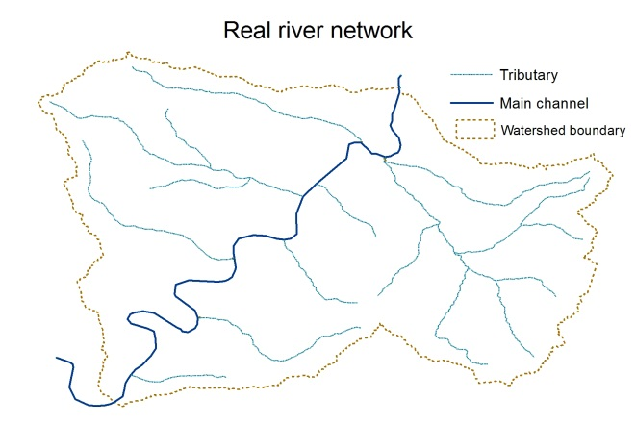
A New Physically Based Large Scale River Routing Model for Coupling with Earth System Models
Objective
Develop a physically based runoff routing model, Model for Scale Adaptive River Transport (MOSART), for coupling with land surface and earth system models across local, regional and global scales
Approach
Divide each spatial unit into hillslope, tributaries and main channel and describe them separately
All model parameters are physically based, with only a small subset requiring calibration
Evaluate simulations at multiple resolutions against observed streamflow and channel velocity from USGS stations
MOSART explicitly represents subgrid and channel routing in a scale-consistent way
Conceptualized network
Hillslope routing
Tributary routing
Main channel routing
Impact
MOSART provides a flexible framework for modeling terrestrial fluxes into the ocean for complete linkages across the atmosphere, land, and ocean components in earth system models.
The model also serves as a cornerstone for integrating the human and earth system components of the water cycle.
Li H, MS Wigmosta, H Wu, M Huang, Y Ke, AM Coleman, and LR Leung. 2013. “A physically based runoff routing model for land surface and earth system models.” Journal of Hydrometeorology, in press February 2013. DOI:10.1175/JHM-D-12-015.1
Notes:
http://www.pnl.gov/science/highlights/highlights.asp?division=749

