Slide 1
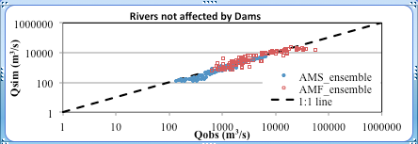
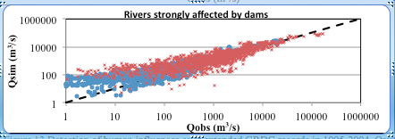
Evaluating Global Streamflow Simulations by a Physically-based Routing Model Coupled with the Community Land Model
Objective
Evaluate the capacity of global streamflow prediction by Model for Scale Adaptive River Transport (MOSART) coupled with Community Land Model (CLM)
Quantify the uncertainty sources from forcing, model structure and human influences
Approach
Develop a comprehensive global hydrography dataset to support MOSART application over multiple resolutions
Evaluate the model simulations against global streamflow observations
Quantify modeling uncertainty using four different atmospheric forcing datasets, stepwise reduction of model complexity, and a global classification of the level of flow regulation by dams
Human influences on streamflow are detected by comparing the simulated natural flows (Qsim) with observed streamflow (Qobs) in 1995-2004. Larger differences between Qsim and Qobs are found in both annual mean streamflow (AMS) and annual maximum flood (AMF) in rivers strongly affected by dams.
Impact
The newly developed river routing model, MOSART, has been coupled with CLM and evaluated globally with satisfactory performance
MOSART provides a global framework for modeling riverine water, energy and biogeochemistry.
Hong-Yi L, LR Leung, A Getirana, M Huang, H Wu, Y Xu, J Guo, and N Voisin. 2015. “Evaluating Global Streamflow Simulations by a Physically Based Routing Model Coupled with the Community Land Model.” Journal of Hydrometeorology, 16: 948–971. DOI: 10.1175/JHM-D-14-0079.1
Notes:
http://www.pnnl.gov/science/highlights/highlights.asp?division=749

