Slide 1
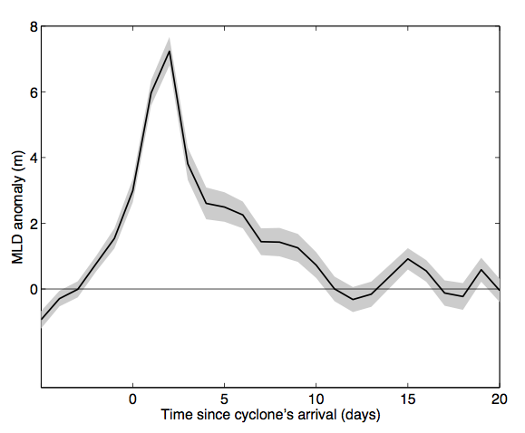
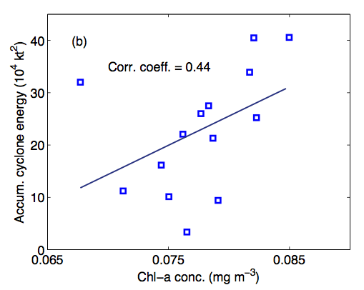
Tropical Cyclones Impacts on Sea-Surface Chlorophyll
Objective
Evaluate the impacts of tropical cyclones on the integrated sea- surface chlorophyll in the subtropical North Atlantic
Approach
Use 14 years of tropical cyclone track data and satellite chlorophyll data for the period 1998-2011
Use high resolution HYCOM ocean reanalysis data for the 5-year period 2008-2013
Estimate tropical cyclone-induced mixed layer depth anomalies and their interannual variability
Compute the interannual variability in the seasonal and area-averaged sea-surface chlorophyll and compare it with the year-to-year variability in tropical cyclone activity
Left: Composite mean time evolution of tropical cyclone-induced mixed layer depth anomalies computed using daily data from HYCOM ocean reanalysis. Right: Scatter between the accumulated cyclone energy and tropical cyclone season-averaged satellite sea -surface chlorophyll-a concentration.
Impact
Tropical cyclones induce significant mixed layer anomalies in the Sargasso Sea—nearly 12% of the interannual variability in mixed layer depth can be explained by that from tropical cyclone activity
About 22% of the year-to-year variability in tropical cyclone season- and area-averaged sea-surface chlorophyll can be accounted for by tropical cyclones, with potential implications to oceanic carbon sequestration and global carbon cycle.
Foltz GR, K Balaguru, and LR Leung. 2015. “A Reassessment of the Integrated Impact of Tropical Cyclones on Sea Surface Chlorophyll in the Western Sub-Tropical North Atlantic.” Geophysical Research Letters 42. DOI: 10.1002/2015GL063222
Notes:
http://www.pnnl.gov/science/highlights/highlights.asp?division=749

