Slide 1
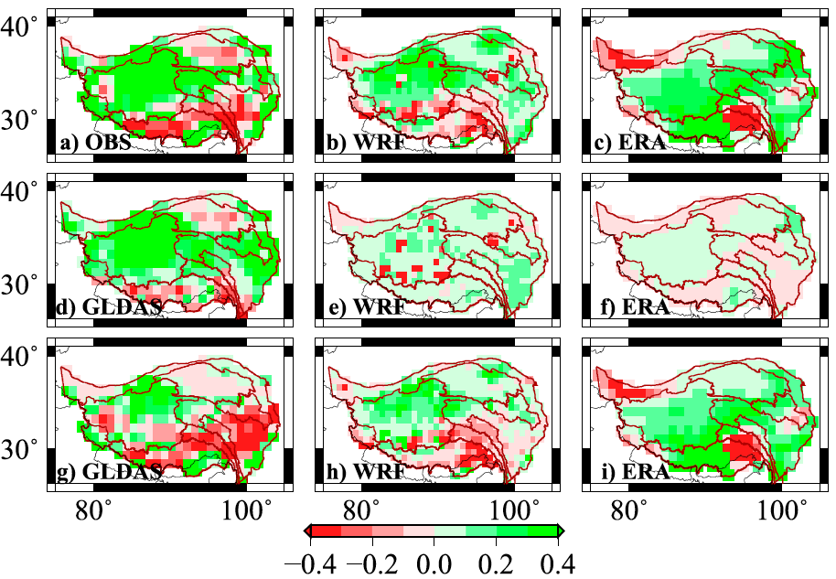
Changes in Moisture Flux over the Tibetan Plateau During 1979-2011: Insights from a High-Resolution Simulation
Objective
To quantify the moisture flux changes over the Tibetan Plateau (TP) in recent decades and understand the mechanisms for the changes
Approach
Perform a high resolution regional climate simulation over the TP at 30 km resolution
Compare moisture flux changes between 1998-2011 and 1979-1997 from the regional climate with its global reanalysis forcing and the Global Land Data Assimilation System (GLDAS) product
Analyze the thermodynamic, dynamic, and transient eddy components of column integrated moisture flux convergence to determine processes contributing to the moisture flux changes in the last three decades
Changes in precipitation (top), evapotranspiration (middle), and net precipitation (bottom) from observations (left), a regional simulation using the WRF model (middle), and ECMWF global reanalysis (right) between 1979-2011 (unit: mm day⁻¹).
Impact
Net precipitation (precipitation minus evapotranspiration) exhibits general increases in the vast northwestern TP and decreases in the southeastern TP between 1979-2011
Net precipitation changes are driven primarily by large-scale circulation changes, but contrasting topography and land surface cover in the northwestern and southeastern TP trigger differences in upward motion that enhance regional contrast in changes through latent heat release and feedback on the moisture flux convergence
Y Gao, LR Leung, Y Zhang, and L Cuo. 2015. “Changes in Moisture Flux over the Tibetan Plateau during 1979-2011: Insights from a High-Resolution Simulation.” Journal of Climate 28(10). DOI:10.1175/jcli-d-14-00581.1.
Notes:
http://www.pnnl.gov/science/highlights/highlights.asp?division=749

