Slide 1
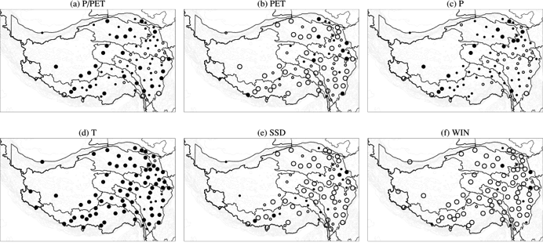
Aridity Changes in the Tibetan Plateau in a Warming Climate
Objective
Quantify aridity changes in the Tibetan Plateau (TP) in recent decades and attribute changes to different climatic factors
Approach
Use the ratio of precipitation to potential evapotranspiration (P/PET) as an aridity index
Use observed meteorological records at 83 stations in the TP and the Penman-Montieth algorithm to calculate PET and P/PET
Analyze the spatial and temporal changes in aridity and relate them to changes in climatic factors including temperature, precipitation, sunshine duration, diurnal temperature range, and wind speed
Spatial distribution of annual variation trend of P/PET, PET, P, T, sunshine duration (SSD), and wind (WIN) in the TP from 1979-2011 showing reduced aridity in northwestern TP and increased aridity in eastern TP, which is correlated most strongly with changes in precipitation (P).
Impact
Analysis of observations shows that the arid and semi-arid northwestern TP is becoming wetter, while the semi-humid eastern TP is getting drier in the last three decades
Precipitation is the most dominant driver of aridity changes in the TP; changes in snowmelt in the warm season due to warmer temperature also influence aridity
Y Gao, X Li, LR Leung, D Chen, and J Xu. 2015. “Aridity Changes in the Tibetan Plateau in a Warming Climate.” Environmental Research Letters 10(3). DOI:10.1088/1748-9326/10/3/034013.
Notes:
http://www.pnnl.gov/science/highlights/highlights.asp?division=749

