Slide 1
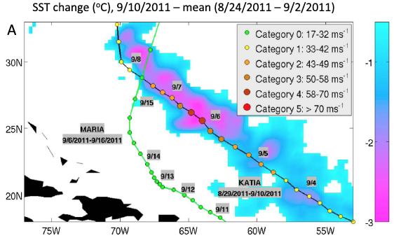
Cyclone-Cyclone Interactions Through the Ocean Pathway
Objective
Study how the lingering cold wake from one tropical cyclone may influence the intensity of a later cyclone that passes over the cold wake
Systematically quantify the frequency and impacts of these cyclone-cyclone interactions on mean cyclone intensification rates in the three most active cyclone basins
Approach
Performed data analysis and numerical modeling of two cyclones, Katia and Maria, as a representative case study of cyclone-cyclone interactions in the North Atlantic
Analyzed observational data from 1984–2011 to quantify the frequency of occurrence of cyclone-cyclone interactions and their impacts on basin mean cyclone intensification rates in the North Atlantic, eastern Pacific, and northwestern Pacific
Interaction of cyclones Katia and Maria in the North Atlantic (September 2011). The SST cooling (ºC) induced by Katia is shown in the background with the tracks of cyclones Katia and Maria overlaid.
Impact
Cyclones have, on average, ∼10% chance to interact with wakes and such interactions reduce the mean intensification rates for cyclones by 3%–6% on average, and by ∼12%–15% during the most active years
Identified and quantified “Cyclone-cyclone interactions” through the ocean pathway as a mechanism through which tropical cyclones may self-regulate their activity to an extent on intraseasonal time scales, with potential implications for future cyclone activities in a warmer climate.
Balaguru K, S Taraphdar, LR Leung, GR Foltz, and JA Knaff. 2014. “Cyclone-cyclone Interactions through the Ocean Pathway.” Geophysical Research Letters 41, early online. DOI:10.1002/2014GL061489.
Notes:
http://www.pnnl.gov/science/highlights/highlights.asp?division=749

