Slide 1
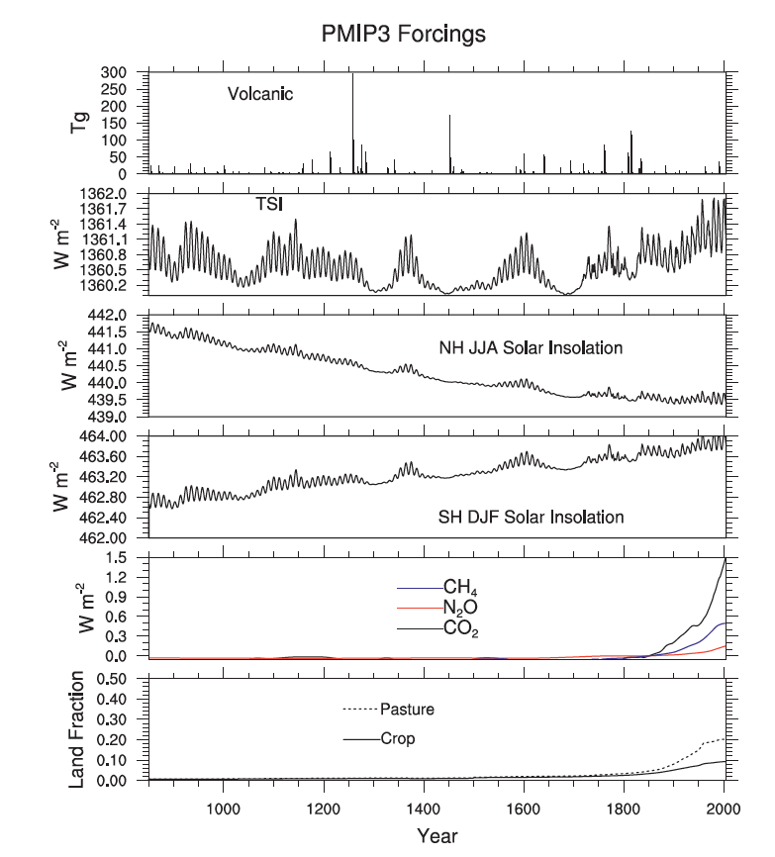
Last Millennium Climate and Its Variability in CCSM4
Laura Landrum, Bette L. Otto-Bliesner, Andrew Conley, Peter Lawrence, Nan Rosenbloom and Haiyan Teng
Objective
Evaluate model variability on multidecadal and longer time scales
Provide a long-term perspective for detection and attribution studies
Approach
Force CCSM4 from year 850 to 1850 following the protocols of PMIP3.
Impact
An important component of CMIP5
An article under the same title was published by J. Climate.
Landrum et al. 2013: Last millennium climate and its variability in CCSM4. J. Climate, DOI: 10.1175/JCLI-D-11-00326.1 .

