Slide 1
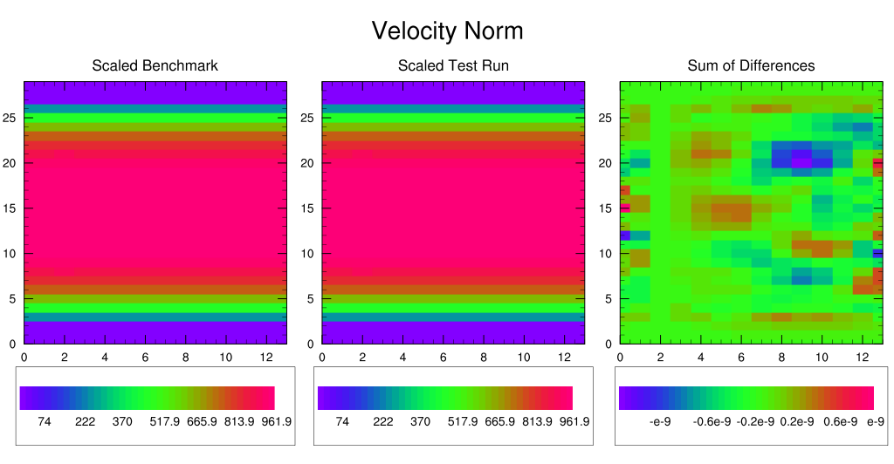
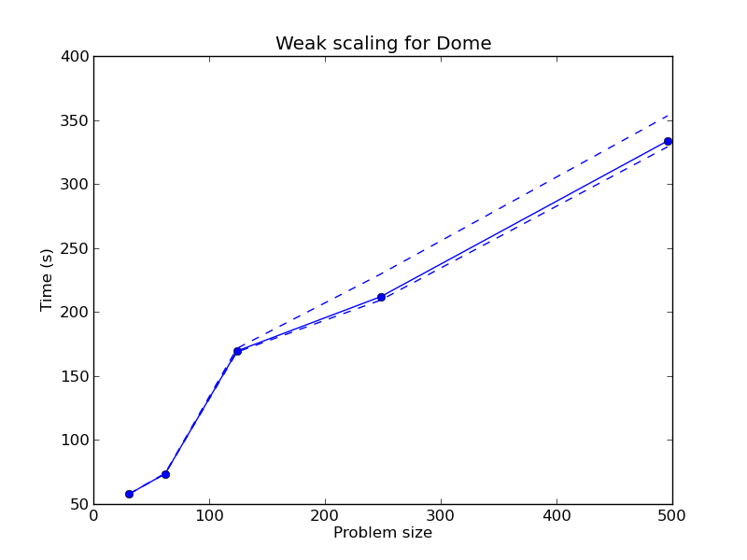
Land Ice Verification and Validation (LIVV) Kit
Objective: Automated tool to evaluate ice sheet models
Release 1.0, https://github.com/LIVVkit/LIVVkit
July 15, 2015
New Science:
Provides comprehensive comparisons for a suite of benchmark tests of the Community Ice Sheet Model
Tested on desktop systems and Leadership Class Computing Facilities
Generates a wealth of data and plots for a suite of test cases on a hierarchical webpage
Significance
First toolkit to comprehensively evaluate a continental scale ice sheet model
Supports The DOE BER Accelerated Climate Model for Energy land ice and coupled model development efforts
Provides novel, performance-based V&V to detect performance changes and provide a cost-benefit to code improvements
Example output from a stream flow test case using LIVV http://acme-climate.github.io/LIVV/
Weak scaling behavior for a large dome- shaped test case. It shows that the scaling behavior of a new run fits within the previous range of performance for this case
Contact: Kate Evans evanskj@ornl.gov; Funded by BER/ASCR SciDAC PISCEES project. Steve Price, LANL, PI
Notes:
Contact: Kate Evans evanskj@ornl.gov; Funded by BER/ASCR SciDAC 3 PISCEES project. S. Price, LANL, PI

Slide 2
Land Ice Verification and Validation (LIVV) Kit
Summary
Dynamic ice sheet models are a new component for Earth System Models such as DOE’s Accelerated Climate Model for Energy (ACME). As these ice sheet models are developed, it is challenging for the developer to easily test the code, both computationally and in comparison with measurements. To address this, DOE’s Predicting Ice Sheets and Climate Evolution of Extremes (PISCEES) SciDAC project has released the first automated capability to verify continental ice sheets models with an advanced and robust software capability, the Land Ice Verification and Validation kit, or LIVVkit, which has just been released for use by the broader ice-sheet community. This python, web-based software package is a comprehensive and extensible model testing framework, and it enables computational and climate scientists to quickly and easily verify model changes on multiple desktop and Leadership Class Computing platforms, document the changes quantitatively and graphically, and use the results to build confidence in the new, DOE-sponsored Community Ice Sheet (CISM) model. The performance aspect of LIVV allows users to quantitatively identify performance bugs as well as computational improvements and degradations as the model is developed. It includes scalability analysis (i.e. showing how well the model can be parallelized) for large problems. This first release allows model developers outside the DOE to utilize a continental-scale ice sheet evaluation capability, and it is the basis for future development for a comprehensive validation capability of stand-alone ice sheet and coupled Earth system models. This software package will enable faster development and going forward, provide increased confidence in an ice sheet model predictive capability.
Contact: Kate Evans evanskj@ornl.gov; Funded by BER/ASCR SciDAC PISCEES project. Steve Price, LANL, PI
Notes:
2

