Slide 1
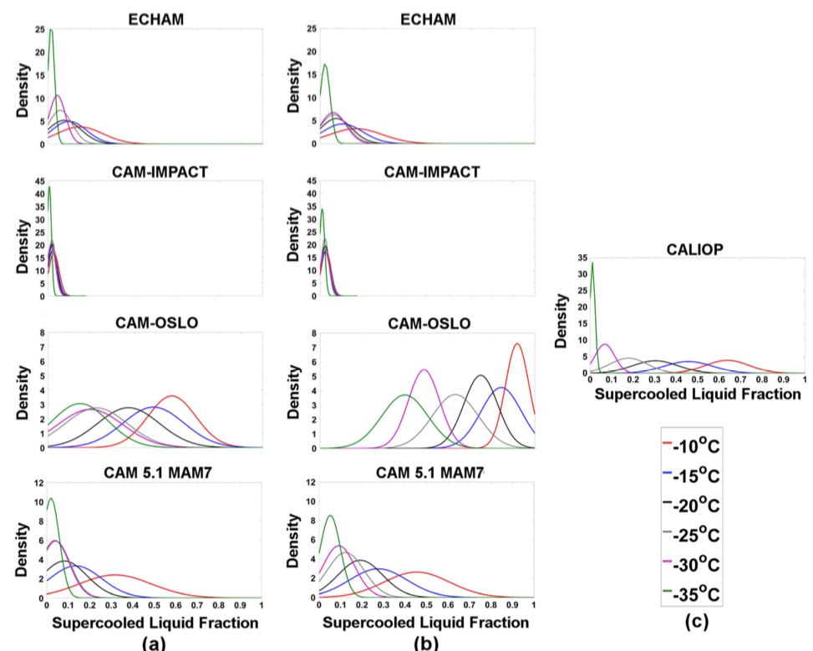
AeroCom intercomparison of cloud water phase among global climate models
Objective
To evaluate several global climate models (GCMs) in simulating the cloud ice and cloud water partitioning in mixed-phase clouds.
Approach
The phase partitioning of cloud water is compared among six state-of-the-art GCMs and with NASA Cloud and Aerosol Lidar with Orthogonal Polarization (CALIOP) retrievals.
Supercooled liquid fraction (SLF) from GCMs is sampled at cloud tops to be consistent with clouds that would be observed by CALIOP.
Impact
GCMs predict vastly different distributions of cloud phase for a given temperature and all of them failed to preserve sufficient liquid water at mixed-phase cloud temperatures.
The results suggest that processes responsible for the conversion from liquid water to ice are at least as important as ice nucleation in determining cloud phase partitioning simulated by GCMs.
Normal distribution fits to the PDFs of supercooled liquid fraction for ECHAM6, CAM-IMPACT, CAM-OSLO, and CAM5.1-MAM7, for (a) each model with its default heterogeneous ice nucleation parameterizations, (b) all models with the same ice nucleation parameterization of DeMott et al. (2010) , and (c) CALIOP.
Komurcu, M., T. Storelvmo, I. Tan, U. Lohmann, Y. Yun, J. E. Penner, Y. Wang, X. Liu, and T. Takemura (2014), Intercomparison of the cloud water phase among global climate models, J. Geophys. Res. Atmos., 119, 3372–3400, doi:10.1002/2013JD021119.

