Slide 1
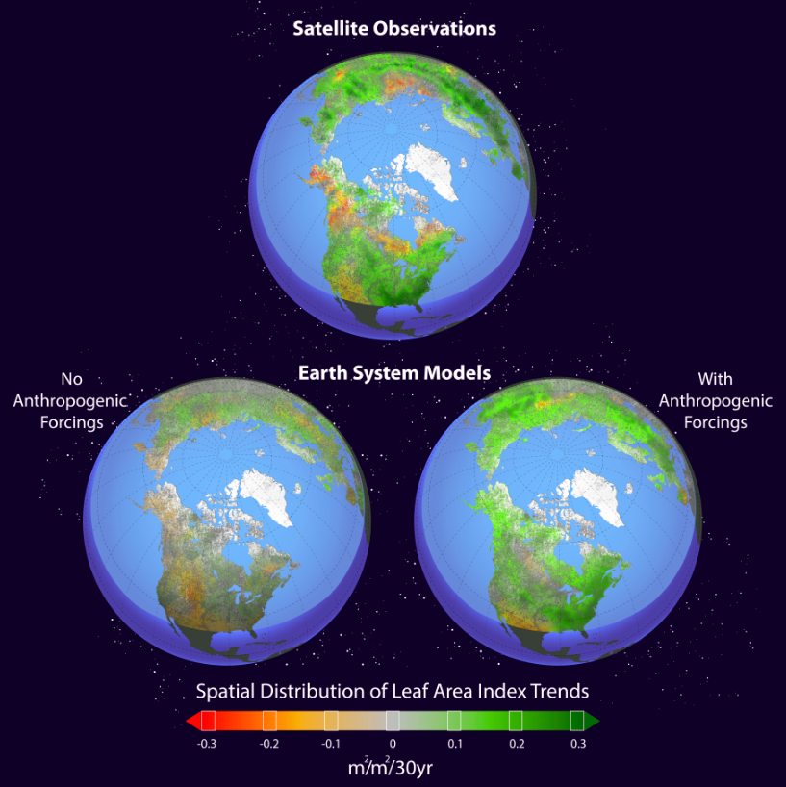

Human-induced greening of the northern extratropical land surface
Objective
Two long-term satellite leaf area index (LAI) datasets, 19 coupled earth system models (ESMs) and a formal detection and attribution algorithm were used to attribute changes of vegetation activity in the northern-extratropical latitudes (NEL) for the period 1982-2011.
New Science
Significant land greening in the NEL was captured by satellite observations and ESMs simulations with historical anthropogenic and natural forcings.
The trend of strengthened northern vegetation greening is clearly distinguishable from both internal climate variability and the response to natural forcings alone.
The observed greening record can be rigorously attributed, with high statistical confidence, to anthropogenic forcings, particularly to rising atmospheric concentrations of greenhouse gases.
Significance
We clarified mechanisms driving NEL vegetation dynamics for the past 3 decades.
We demonstrated the first clear evidence of a discernible human fingerprint on physiological vegetation changes other than phenology and range shifts.
We propose new areas for detecting and attributing the terrestrial ecosystem dynamics across broad spatial and temporal scales.
Contact: Jiafu Mao (maoj@ornl.gov)
Funding: This work was supported by DOE Office of Science, Biological and Environmental Research: RGCM, TES, and ESM programs
Citation: Jiafu Mao*, Aurélien Ribes, Binyan Yan, Xiaoying Shi, Peter E. Thornton, Roland Séférian, Philippe Ciais, Ranga B. Myneni, Hervé Douville, Shilong Piao, Zaichun Zhu, Robert E. Dickinson, Yongjiu Dai, Daniel M. Ricciuto, Mingzhou Jin, Forrest M. Hoffman, Bin Wang, Mengtian Huang, and Xu Lian, 2016. Human-induced greening of the northern extratropical land surface.
Nature Climate Change, 10.1038/nclimate3056.
Spatial distribution of LAI trends observed by satellite and simulated by CMIP5 models over the period 1982–2011.

