Slide 1
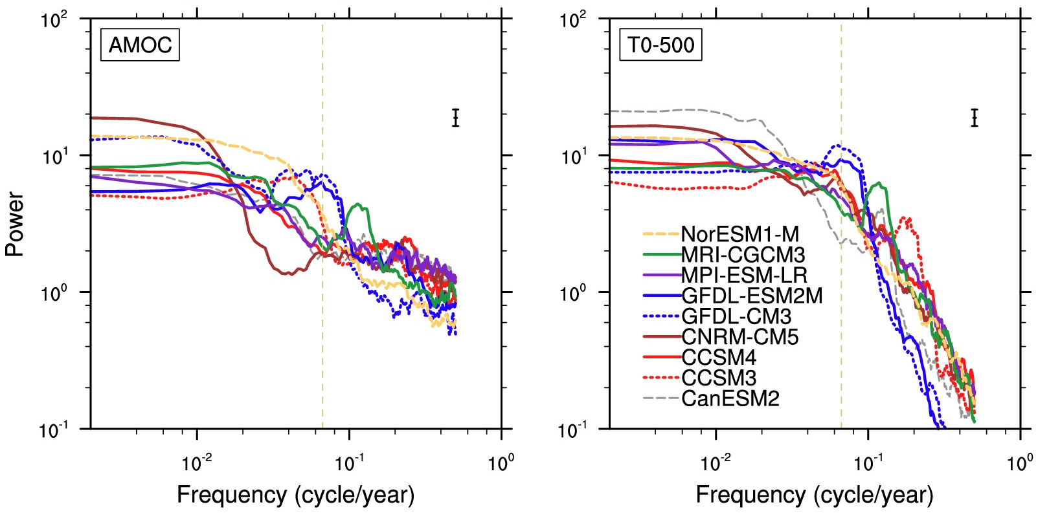
Is AMOC more predictable than North Atlantic heat content?
Predictability properties of the North Atlantic meridional overturning circulation (AMOC) are measured and compared to those of upper 500m heat content in the North Atlantic based on control simulations from CCSM3 and eight CMIP5 models.
For annual mean AMOC the predictability limit is about a decade. For 5- and 10-year averages predictability is substantially greater than for annual means for both AMOC and heat content but the enhancement is more for AMOC. There are spatial patterns of AMOC that have especially high predictability, which may have a positive influence on the predictability of heat content. The most predictable of these may be predictable for nearly 2 decades.
The study provides guidance for interpretation of the CMIP5 prediction experiments and for experimental design for future prediction experiments.
Top row: power spectra of the AMOC (30S-70N) and the North Atlantic upper 500m (T0-500) heat content (20-70N, 80W-0E) based on the 10 leading 10PCs. Bottom row: mean square error (MSE) based on the 10 PCs.
Branstator, G. and H. Teng, 2014: Is AMOC more predictable than North Atlantic heat content?
Journal of Climate, accepted.

