Slide 1
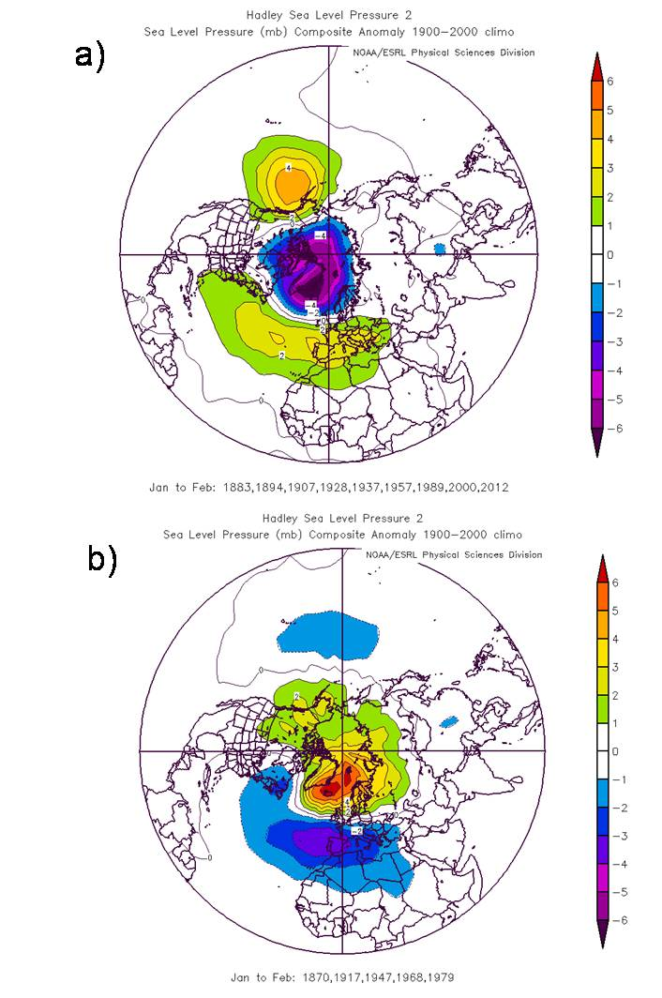
Interactions between externally-forced climate signals from sunspot peaks and the internally-generated Pacific Decadal and North Atlantic Oscillations
Objective
The key to knowing how future climate may evolve is to better understand historical climate fluctuations that involve a mixture of naturally-occurring variability (e.g. the Pacific Decadal Oscillation, PDO; or North Atlantic Oscillation, NAO) and externally-forced responses (e.g. from humans such as increasing greenhouse gases, or natural such as from solar variability). Part of the mystery in how the climate system responds to the solar forcing from the 11 year sunspot cycle is that the climate signals appear to be intermittent. Here we provide some insight as to why that may be.
The pattern of winter sea level pressure anomalies associated with the NAO can be opposite, depending on whether the NAO is in phase with the 11 year solar cycle (top) or out of phase (bottom)
Approach
Analyze historical observations of sea level pressure (SLP) and sea surface temperature (SST)
Composite years with sunspot peaks grouped by positive or negative phases of the PDO and NAO
Impact
The phasing of the internally-generated PDO and NAO can interact with the externally forced response from the solar cycle to produce different climate signals depending on the phase of the solar cycle.
Van Loon, H., and G.A. Meehl, 2014: Interactions between externally-forced climate signals from sunspot peaks and the internally-generated Pacific Decadal and North Atlantic Oscillations, Geophys. Res. Lett., DOI: 10.1002/2013GL058670.

