Slide 1
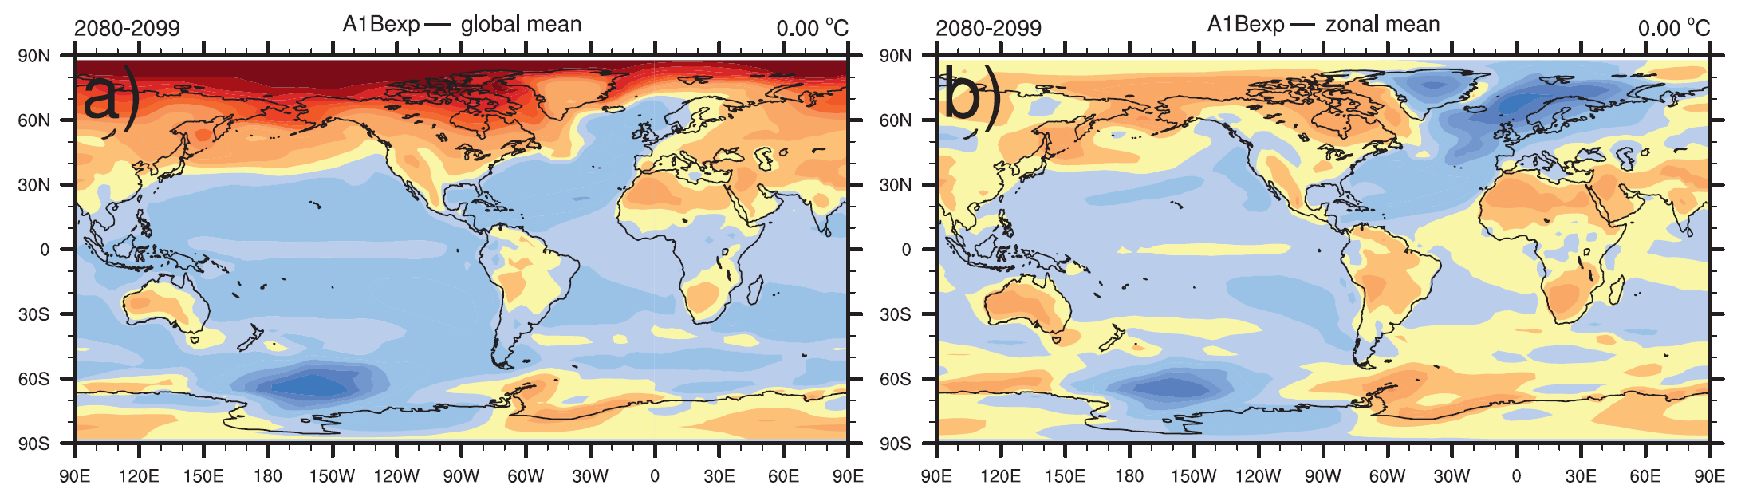
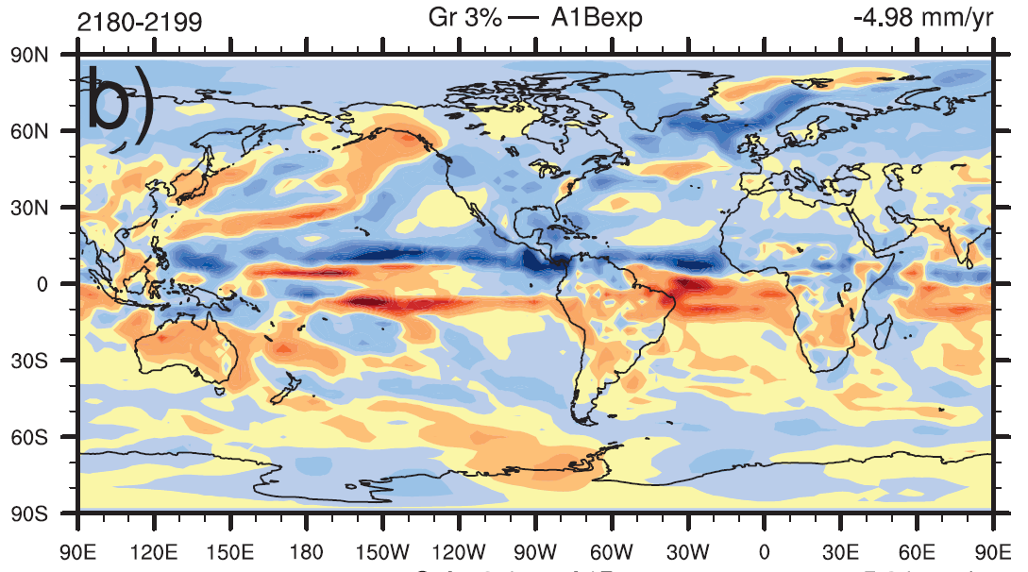
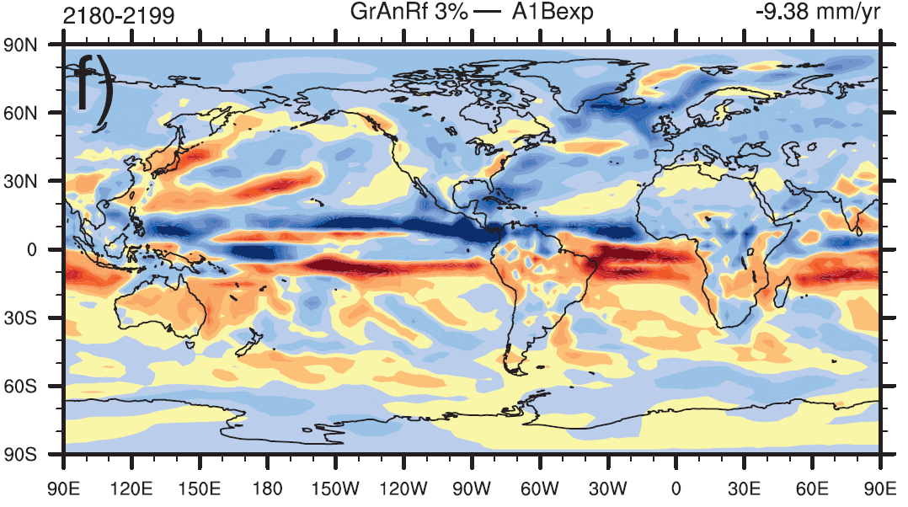
Influence of continental ice retreat on future global climate
Objective
Continental ice loss has become a significant contributor to recent global sea level rise. However, this freshwater runoff from land to ocean can also affect other aspects of the global climate. Here we study the potential influence of these continental ice runoff on the regional and global climate under a series idealized climate model simulations with special focus on the changes of the Atlantic Meridional Overturning Circulation (AMOC), and the changes of regional temperature and precipitation.
Surface temperature anomaly in A1B relative to the global mean warming (top left) and zonal mean warming (top right), and precipitation anomaly in Gr3% (bottom left) and GrAnRf3% (bottom right) relative to A1B simulation.
Approach
CCSM3 is used as the primary tools for this study.
9 simulations are used here: a standard SRES A1B, A1B+0.01Sv Greenland Ice sheet (GrIS) melting with 1% and 3% increase per year, A1B+0.01Sv glacier and ice cap (GIC) melting with 1% and 3% increase per year, A1B+0.002Sv Western Antarctic ice sheet (WAIS) melting with 3% increase per year; and A1B+GrIS+WAIS 3%, and A1B+GrIS+WAIS +GIC 1% and 3%.
Impact
Our results show that the AMOC will not slow down further unless the runoff from Greenland ice large enough. When AMOC slows further due to large runoff from melting land ice, it will lead to a reduced rainfall in North America and increased in Australia, it also leads to a reduced warming in Europe than otherwise.
These changes in rainfall and surface temperature could generate significantly societal impact.
Hu, A., G. A. Meehl, W. Han, J. Yin, B. Wu, and M. Kimoto, 2013, Influence of continental ice retreat on future global climate, J. Climate Change, 26, 3087-3111, doi:10.1175/JCLI-D-12-00102.1.

