Slide 1
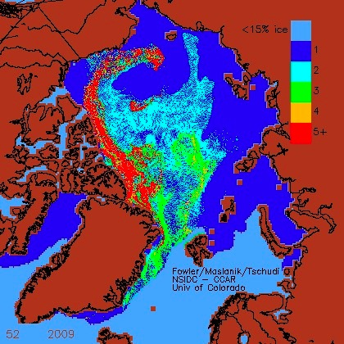
Sea ice volume and age: Sensitivity to physical parameterizations and thickness resolution in the CICE sea ice model
Objective
To combine age and volume analyses to discriminate among the effects of parameterizations that are not easily distinguished in terms of ice area or volume alone.
Approach
Compare model output with satellite derived age and volume observations
Evaluate CICE5 physics options (anisotropic rheology, variable form drag, ridging)
Identify layer, thickness distribution (ITD) resolution sensitivities, biases
Analyze dynamic-thermodynamic process interactions that lead to biases
Sea ice age (year) from (left) observations and (right) CICE, using the variable form drag parameterization.
Impact
Five thickness categories are insufficient to resolve ITD; additional thick-ice categories are needed.
New physics packages need to be tuned.
Dynamic-thermodynamic feedback processes can have counter-intuitive impacts on ice volume and age.
Hunke, E. C. Sea ice volume and age: Sensitivity to physical parameterizations and resolution in the CICE sea ice model. Ocean Modelling, DOI: 10.1016/j.ocemod.2014.08.001. LA-UR-14-21531

