Slide 1
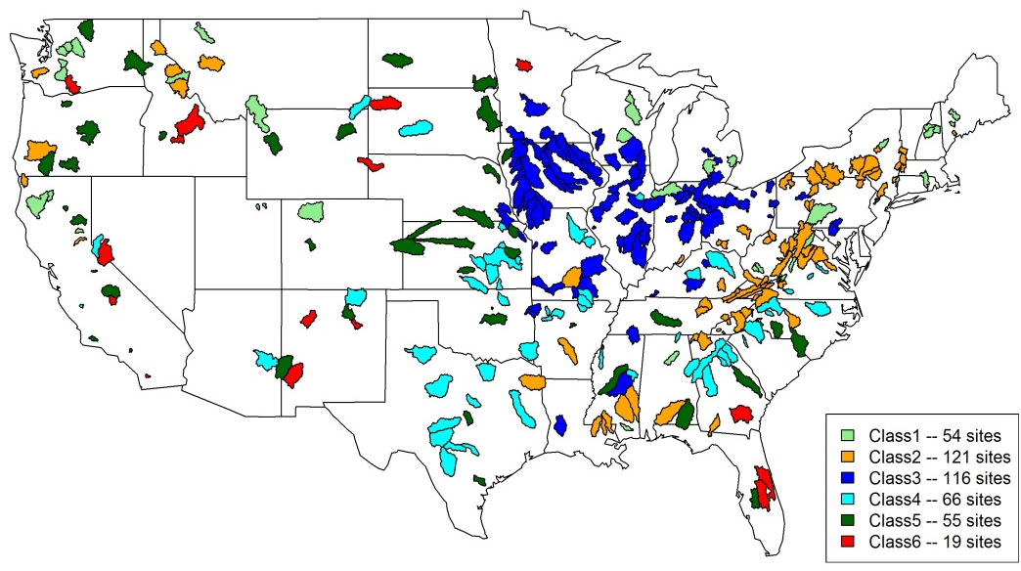
Classification of Hydrological Parameter Sensitivity and Evaluation of Parameter Transferability across 431 US MOPEX Basins
Sensitivity-based classification of the 431 MOPEX Basins basins
Objective
Evaluate the potential of optimizing and transferring hydrologic model parameters in CLM across watersheds from the Model Parameter Estimation Experiment (MOPEX) in the United States
Approach
Employ an integrated uncertainty quantification framework including entropy-based derivations of prior distributions of input parameters, efficient sampling, expectation-maximization clustering, and model optimization
Perform forward modeling and sensitivity analyses for all 431 MOPEX basins over the US
Use parameter sensitivity patterns/ attributes, together with climate and soil conditions to classify the basins
Evaluate transferability of parameter sensitivity attributes within each class through model optimization at representative sites
Impact
The classification yields six classes based on the sensitivity of streamflow simulations to the variations of the hydrological parameters. The classes serve as a basis for further climate evaluations or model optimizations.
By reducing the parameter dimensionality to a reasonably low number, the classification makes model optimization/calibration possible and less ill-posed.
Same optimization strategy can be used within each class. Model optimization effort can be further reduced given the parameter similarity and transferability.
Ren H, Z Hou, M Huang, J Bao, Y Sun, T Tesfa, LR Leung. 2016. “Classification of Hydrological Parameter Sensitivity and Evaluation of Parameter Transferability Across 431 US MOPEX Basins.” Journal of Hydrology 536: 92-108. DOI: 10.1016/j.jhydrol.2016.02.042
Notes:
http://www.pnnl.gov/science/highlights/highlights.asp?division=749

