Slide 1
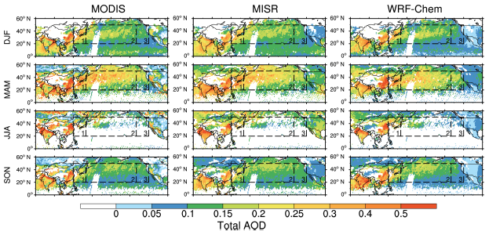
Trans-Pacific Transport and Evolution of Aerosols: Evaluation of Quasi-Global WRF-Chem Simulation with Multiple Observations
WRF-Chem simulated realistic seasonal and spatial distribution of aerosol optical depth (AOD) compared to satellite retrievals (MODIS and MISR)
Objective
Evaluate a quasi-global WRF-Chem simulation of trans-Pacific transport of aerosols using satellite and ground based measurements
Approach
Compare aerosol simulations over the Pacific Ocean with satellite data
Compare aerosol simulations over western North America with in situ aerosol measurements
Analyze seasonal and interannual variability and horizontal and vertical distribution
Perform sensitivity experiments to quantify the contributions of trans-Pacific aerosols to aerosol concentrations in rural areas in western North America
Impact
Aerosols originating from natural and anthropogenic sources in Europe, North Africa, and East Asia can be transported thousands of miles downwind across the Pacific Ocean to North America
The WRF-Chem quasi-global simulation can provide realistic inflow chemical boundary conditions for regional models to simulate the impact of long-range transported aerosols on the regional climate and air quality of western North America.
Hu Z, C Zhao, J Huang, LR Leung, Y Qian, H Yu, L Huang, and OV Kalashnikova. 2016. “Trans-Pacific Transport and Evolution of Aerosols: Evaluation of WRF-Chem Simulations with Multiple Observations.” Geoscientific Model Development 9. DOI: 10.5194/gmd-9-1725-2016
Notes:
http://www.pnnl.gov/science/highlights/highlights.asp?division=749

