Slide 1
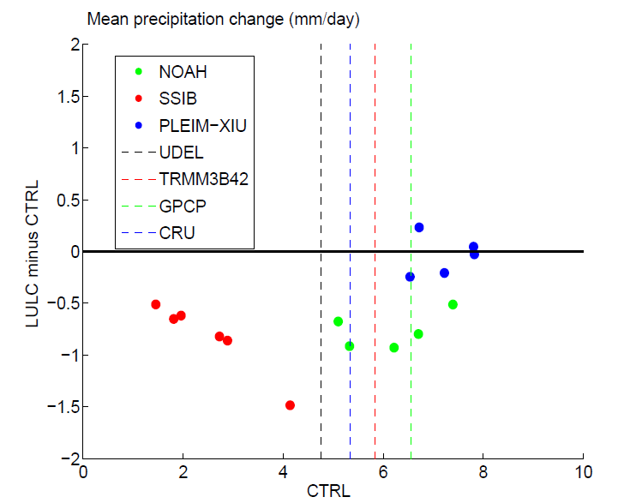
Estimating the Impact of Land-Use Change on African Monsoon Precipitation
Models that are too dry (far left) or too wet (far right) are less sensitive to land use land cover change
Objective
Examine the uncertainties in model simulated response in the African Monsoon system and Sahel precipitation to Land Use/Land Cover (LULC) change and the relationship of the response to model climatology
Approach
Run a set of 16 regional model simulations with different combinations of land surface and cumulus parameterization schemes with control and degraded land surface conditions
Compare simulated precipitation and surface flux variables with observations and analyze their relationship with the response to the LULC change
The mean summer precipitation change (mm/day) in response to prescribed, observed LULC change vs the control climatological values. The dashed lines represent those from observations.
Impact
Too dry or too wet model simulations are less sensitive to land use land cover change because of moisture and energy limits respectively
Observed LULC change over the last 60 years reduces the model precipitation by about 10%, in simulations that realistically reproduce the climatology.
Hagos S, R Leung, M Huang, J Yoon, N Neupane, Y Xue, A Boone, and F DeSales. 2014. “Assessment of Uncertainties in the Response of the African Monsoon Precipitation to Land Use Change in Regional Model Simulations.” Climate Dynamics, in press March 2014.
DOI: 10.1007/s00382-014-2092-x
Notes:
http://www.pnl.gov/science/highlights/highlights.asp?division=749

