Slide 1
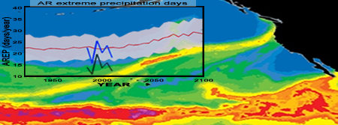
More Rainy Winters Ahead for Western North America
Objective
Project the future frequency of atmospheric river (AR) and associated extreme precipitation by accounting for uncertainties related to model biases and internal variability.
Approach
Analyze a 29-member ensemble of 180-year-long, historical and future simulations from the Community Earth System Model Large Ensemble project.
Account for mode biases in sub-tropical jet position and extreme precipitation dependence on moisture supply.
Compare the response to climate change with effects of bias and spread due to natural variability.
The annual number of atmospheric river related extreme precipitation days. The shading indicates +/- one standard deviation of the natural variability. The black and blue lines mark observations.
Impact
Under business-as-usual emissions scenarios between the last twenty years of the 20th and 21st centuries, AR-related extreme precipitation days are projected to increase by 28%.
This is much larger than the uncertainties associated with model bias (1%) and natural variability (7%).
Hagos SM, LR Leung, J Yoon, J Lu, and Y Gao. 2016 “A Projection of Changes in Landfalling Atmospheric River Frequency and Extreme Precipitation Over Western North America from the Large Ensemble CESM Simulations,” Geophysical Research Letters 43. DOI: 10.1002/2015GL067392
Notes:
http://www.pnnl.gov/science/highlights/highlights.asp?division=749

