Slide 1
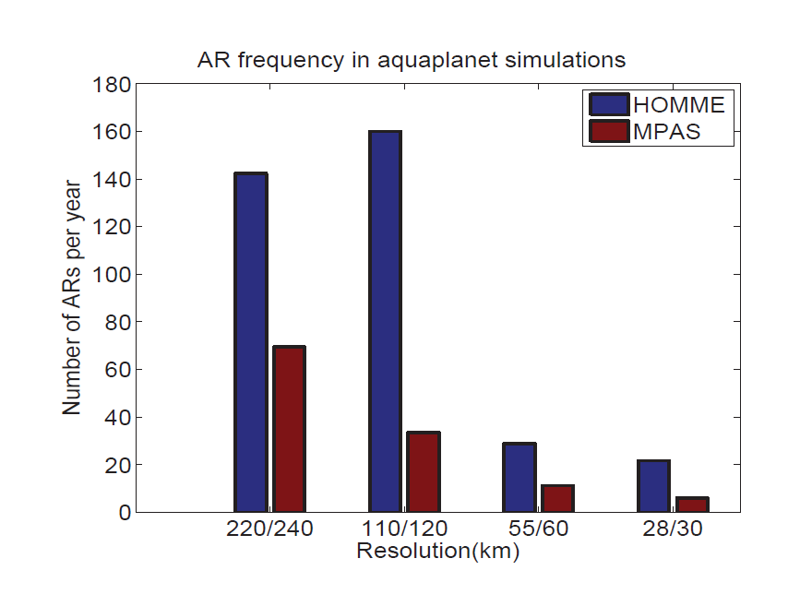
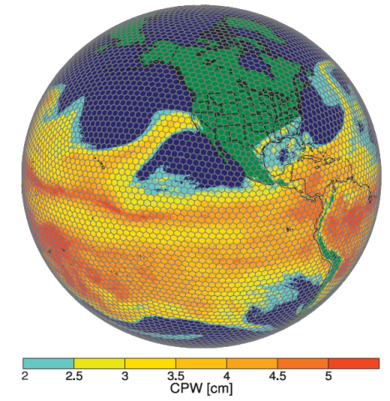
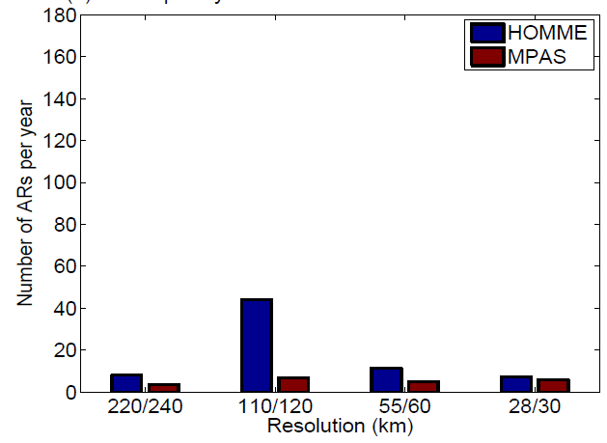




Resolution and Dynamical Core Dependence of Atmospheric River Frequency in Global Model Simulations
Objective
Examine the sensitivity of atmospheric river (AR) frequency simulated by a global model to grid resolutions and dynamical cores.
Identify the differences in model climatology of large-scale conditions responsible for these sensitivities.
Approach
Perform simulations with the Community Atmosphere Model (CAM4) at 240, 120, 60 and 30 km model resolutions each with the Model for Prediction Across Scales (MPAS) and High-Order Methods Modeling Environment (HOMME) dynamical cores.
Determine AR frequency using absolute and percentile thresholds of large-scale atmospheric conditions to identify causes of the sensitivity of AR frequency to model resolution and dynamical cores.
TOP: an example of a simulated AR making a landfall.
TOP RIGHT: The number of AR snapshots per year from 6 hourly CAM4 model outputs.
BOTTOM RIGHT: Same as above, but with AR defined using percentile thresholds to account for differences in the latitudes of subtropical westerlies, total and vertical distribution of
precipitable water content simulated at different resolutions by the MPAS and HOMME dycore.
Impact
AR frequency in CAM4 is sensitive to both model resolution and dynamical core that change the sub-tropical westerlies and the total and vertical distribution of atmospheric precipitable water content.
This study motivates the need to reduce uncertainty in modeling AR responsible for heavy precipitation and flooding in the western U.S. and other regions.
Hagos S, LR Leung, Q Yang, C Zhao, and J Lu. 2015. “Resolution and Dynamical Core Dependence of Atmospheric River Frequency in Global Model Simulations.” Journal of Climate, early online. DOI:10.1175/JCLI-D-14-00567.1
Notes:
http://www.pnnl.gov/science/highlights/highlights.asp?division=749

