Slide 1
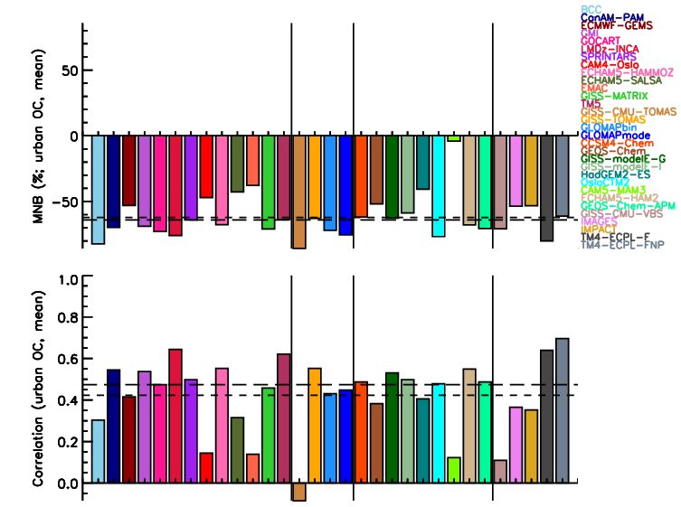
The AeroCom Evaluation and Intercomparison of Organic Aerosol in Global Models
Objective
To observe how well the sources, chemistry, transport and removal of primary and secondary organic aerosol are understood
Approach
Collect common diagnostics from thirty-one global organic aerosol model simulations
Compare the concentrations, atmospheric burdens and lifetimes of simulated organic aerosols
Evaluate the simulated concentrations with data
Mean normalized bias (top) and correlation (bottom) between simulated and measured urban organic carbon concentration by the AeroCom models
Impact
Research found that more complex organic models are no more accurate than simpler models.
Tsigaridis K, et al. 2014. “The AeroCom Evaluation and Intercomparison of Organic Aerosol in Global Models.” Atmospheric Chemistry and Physics 14:10845-10895. DOI:10.5194/acp-14-10845-2014
Notes:
http://www.pnnl.gov/science/highlights/highlights.asp?division=749

