Slide 1
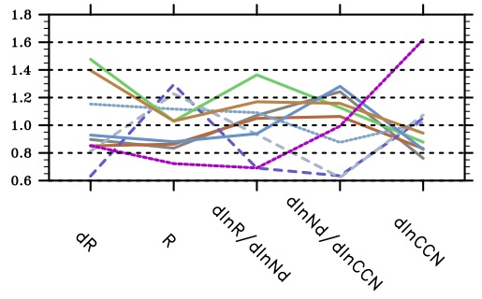
Constraining Estimates of Aerosol Effects on Clouds
Objective
Determine to what extent spatial and temporal variability of clouds, aerosols and solar radiation from recent observations can be used to constrain estimates of aerosol effects on cloud radiative forcing.
Approach
Perform simulations for pre-industrial and present-day emissions of the global cloud-aerosol-radiation systems using nine global aerosol-climate models.
Form averages from 3-hourly samples of liquid clouds
Quantify each term driving the relationship between anthropogenic aerosol emissions and cloud radiative forcing.
Compare estimates of each term using present day variability and using anthropogenic change.
Normalized estimate of each factor driving relationship between the anthropogenic change in cloud radiative forcing (dR) and anthropogenic emissions, using nine different global aerosol-climate models.
Impact
Each term contributes to diversity in radiative forcing
Present-day variability is not a reliable measure of anthropogenic change
Ghan S, M Wang, S Zhang, S Ferrachat et al. 2016. “Challenges in Constraining Anthropogenic Aerosol Effects on Cloud Radiative Forcing using Present-Day Spatiotemporal Variability.” Proceedings of the National Academy of Sciences, early edition. DOI: 10.1073/pnas.1514036113
Notes:
http://www.pnnl.gov/science/highlights/highlights.asp?division=749

