Slide 1
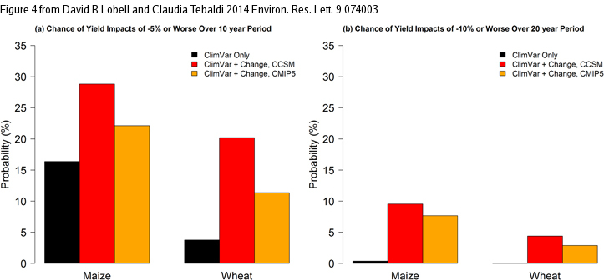
Getting caught with our plants down: the risks of a global crop yield slowdown from climate trends in the next two decades
Objective
Determine whether anthropogenic climate change in the next two decades will enhance the risk of significant slowdowns in corn or wheat production, when compared to the chances of such slowdowns under internal climate variability
Approach
We use the CCSM4 large ensemble, a CCSM4 control simulation and the CMIP5 multimodel ensemble to first determine the probability distribution of trends in Temperature and Precipitation in the next 10 or 20 years, and then translate these into trends in corn and wheat yields through an empirical model. We then compute the chances of significant slowdowns for the three types of simulations, showing that the risk significantly increases under the simulations that include anthropogenic GHG increases.
Chances of climate-induced slowdowns that would roughly halve projected yield trends ((a) 5% yield losses over 10 years and (b) 10% yield losses over 20 years).
Impact
Crop yields have historically been increasing, but we show that under anthropogenic climate change the chances of slowing down such progress significantly are much higher than in the absence of anthropogenic warming. This would posea challenge for crop prodution to keep up with the expected growth in demand, therefore could be important to take this enhanced chances into account to protect us from situation of crisis related to food security.
Lobell, D.B., and C.Tebaldi, 2014: Getting caught with our plants down: the risks of a global crop yield slowdown from climate trends in the next two decades. Environ. Res. Lett. 9 074003 doi:10.1088/1748-9326/9/7/074003

