Slide 1
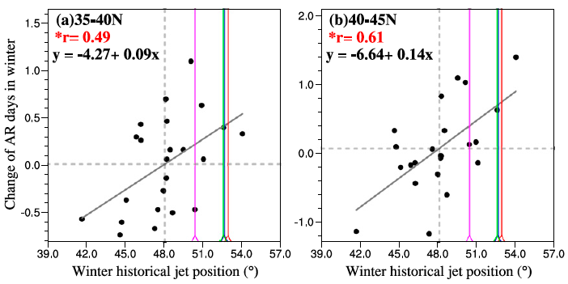
Uncertainties in Projecting Future Changes in Atmospheric Rivers and Their Impacts on Heavy Precipitation over Europe
Objective
Understand the sources of and quantify the uncertainties in projecting future changes in North Atlantic atmospheric rivers making landfall in western Europe
Approach
Detect atmospheric rivers that make landfall in western Europe from the multi-model CMIP5 ensemble simulations for the present and future
Investigate the dynamical (winds) and thermodynamical (moisture) contributions to the changes in atmospheric rivers
Explore the relationship between atmospheric river changes and changes in the jet stream in a warmer climate
Relationships between future changes in AR days (y-axis) and historical jet position (x-axis). Each dot corresponds to one CMIP5 model. The historical jet position in four observation datasets are shown by the colored vertical lines. The correlation coefficients (r) are statistically significant at 95% confidence level.
Impact
The work projects substantial increases in the frequency of atmospheric rivers over western Europe.
While thermodynamics plays a dominant role in the future increase of ARs, meridional shifts in wind speed associated with the jet stream result in dipole change patterns of AR frequency in all seasons.
Using the observed historical jet position as an emergent constraint suggests a larger increase in AR frequency than projected by the models.
Gao Y, J Lu, and LR Leung. 2016. “Uncertainties in Projecting Future Changes in Atmospheric Rivers and Their Impacts on Heavy Precipitation over Europe.” Journal of Climate 29(18): 6711-6726. DOI: 10.1175/JCLI-D-16-0088.1
Notes:
http://www.pnnl.gov/science/highlights/highlights.asp?division=749

