Slide 1
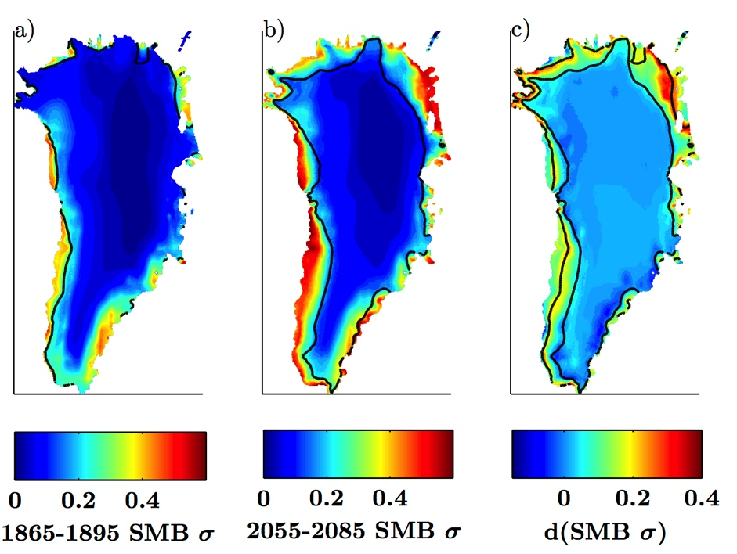
Greenland Ice Sheet surface mass balance variability increases under future climate warming
Objective
Greenland Ice Sheet surface mass balance (SMB) variability is large, and affects regional climate, ice sheet dynamics, and the assessment of Greenland ice loss trends. DOE researchers have performed an assessment of CESM-simulated SMB variability trends between 1850-2100.
Approach
Developed sophisticated SMB calculations within CESM
Carried out historical and CESM SMB-enabled future simulations
Identified Greenland Ice Sheet SMB variability trends in simulated output
Analyzed the physical reasons for variability trends found in model output
Spatial pattern of a) preindustrial, b) late 21st century Greenland Ice Sheet SMB variability. c) difference between the two time periods, showing majority of variability increase occurring in region of ablation zone expansion (between black lines).
Impact
Greenland Ice Sheet SMB variability increases significantly in the future due to a growth of the bare-ice melt (ablation) area. Thus, a increasingly variable Greenland surface conditions will very likely be a physically consistent response to anthropogenic climate change.
Fyke, J.G., M. Vizcaíno M., W.H. Lipscomb, and S. Price (2013), Future climate warming increases Greenland Ice Sheet surface mass balance variability. Geophysical Research Letters, Accepted Articles, doi:10.1002/2013GL058172.

