Slide 1
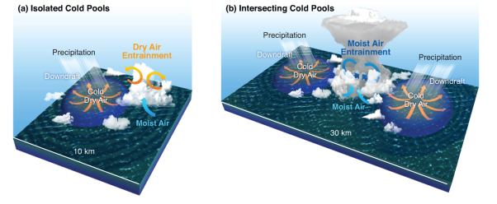
Mechanisms of Convective Cloud Organization by Cold Pools over Tropical Ocean
Objective
Understand the role of precipitation-driven cold pools in deep convective cloud development over the warm tropical Ocean.
Approach
Track cold pools and clouds developed near their boundaries using high-resolution regional model simulation
Evaluate simulated cold pool properties against field campaign observations
Compare statistics of clouds developed along isolated vs. intersecting cold pool boundaries to understand the cause of preferential deep convective cloud developments along cold pool boundaries
Schematic showing the difference in cloud development between isolated and intersecting cold pools
Impact
Current climate model resolution is too coarse to resolve individual convective clouds and must rely on parameterizations, which have biases in reproducing observed storm clouds and precipitation. One reason is cold pool processes are not represented in the climate models.
New approach improves how to represent effects of cold pools on deep convective clouds.
Feng Z, S Hagos, AK Rowe, CD Burleyson, MN Martini and SP de Szoeke. 2015. “Mechanisms of Convective Cloud Organization by Cold Pools over Tropical Warm Ocean during the AMIE/DYNAMO Field Campaign.” Journal of Advances in Modeling Earth Systems, accepted. DOI:10.1002/2014MS000384
Notes:
http://www.pnnl.gov/science/highlights/highlights.asp?division=749

