Slide 1
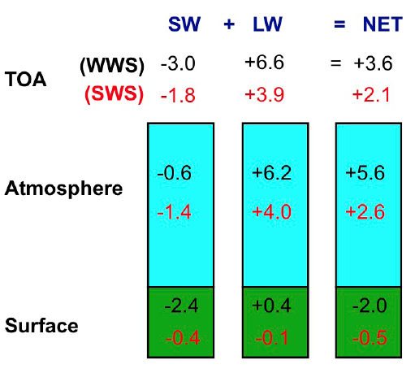
Simulation study shows that atmosphere warms when pollution intensifies storms
Objective
Investigate how pollution interacts with storm clouds and the impacts on the large-scale circulation and radiative forcing.
Research
Used high-resolution, cloud-resolving model to simulate two different types of storm systems at a regional scale: warm summer thunderstorms in southeastern China and cool, windy frontal systems on the Great Plains of Oklahoma.
Found that for warm summer thunderstorms, pollution led to stronger storms with larger anvils, enhanced regional convergence and strong atmospheric warming.
The springtime frontal clouds did not have a similarly significant warming effect. Also, increasing the wind speed in the summer clouds dampened the aerosol invigoration and led to less warming.
Impact
For the first time, show enhanced regional circulation and strong warming effect on the atmosphere through pollution-thunderstorm interactions.
Facilitate parameterization development of aerosol deep-convection interactions in the climate model.
Simulated SW, LW, and net radiative forcing of aerosol indirect effect at the TOA, atmosphere, and the surface for warm summer storm system. Values in red are for the stronger wind shear condition. Very strong warming at TOA and in the atmosphere is seen mainly due to trap more heat from LW radiation. Increasing wind shear dampens the invigoration by aerosols and lead to less warming.
Fan J, D Rosenfeld, Y Ding, LR Leung, and Z Li, 2012, Potential Aerosol Indirect Effects on Atmospheric Circulation and Radiative Forcing through Deep Convection, Geophys. Res. Lett. 39, L09806, DOI 10.1029/2012GL051851.
Notes:
http://www.pnnl.gov/science/highlights/highlights.asp?division=749
Atmospheric Sciences & Global Change Division Research Highlight May 2012
Pollution + Storm Clouds = Warmer Atmosphere Getting a better understanding of the pollution-cloud connection
Results: For the first time, researchers at Pacific Northwest National Laboratory have shown that pollution increases warming in the atmosphere through enlarging thunderstorm clouds. The scientists conducted a computational study with resolutions high enough to allow the team to see the clouds develop. They found that for warm summer thunderstorms, pollution particles lead to stronger storms with large, anvil-shaped clouds. The warming effect dominated by trapping more heat, even though they also reflected some sunlight warmth back into space.
Why it matters: Clouds are one of the most poorly understood components of the Earth’s climate system. Getting a better understanding of clouds, and how pollution and other particles affect their size and influence on the climate, is important to better predict the future of climate change.
“Global climate models don’t see this effect because thunderstorm clouds simulated in those models do not include enough detail,” said Dr. Jiwen Fan, lead author and a scientist at PNNL. “The large amount of heat trapped by the pollution-enhanced clouds could potentially impact regional circulation and modify weather systems.”
For more information, see the PNNL news release, “Pollution teams with thunderclouds to warm atmosphere.” (http://www.pnnl.gov/news/release.aspx?id=925)
Acknowledgments: This study was supported by the U.S. Department of Energy’s (DOE) Office of Science and Biological and Environmental Research (BER) Regional and Global Climate Modeling Program as part of a bilateral agreement with the China Ministry of Sciences and Technology on regional climate research and the U.S. DOE BER’s Atmospheric System Research Program (ASR). The work was performed by Drs. Jiwen Fan and L. Ruby Leung of PNNL; Dr. Daniel Rosenfeld of The Hebrew University of Jerusalem; Dr. Zhanqing Li and Yanni Ding of the University of Maryland.
Reference: Fan J, D Rosenfeld, Y Ding, LR Leung, and Z Li. 2012. “Potential Aerosol Indirect Effects on Atmospheric Circulation and Radiative Forcing through Deep Convection.” Geophysical Research Letters, 39, L09806. DOI:10.1029/2012GL051851.

