Slide 1
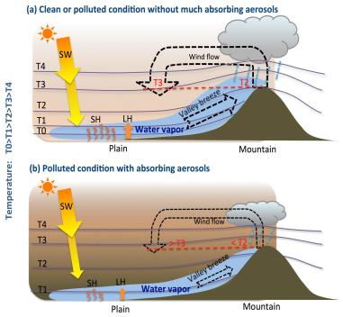
Weakened Mountain Valley Circulation by Pollution Contributing to Suppressed Precipitation in the Mountain Area of Central China
Objective
Examine whether human-caused aerosols over the plain contributed to Mt. Hua area’s reduced precipitation that was observed to be coincident with increased air pollution, and the major mechanisms of the aerosol impact on the downwind mountainous region.
Approach
Employ an improved Weather Research and Forecasting model with online coupled chemistry (WRF-Chem), and conduct one-month summer convective cloud simulations at the convection-permitting scale with the current emission data.
Perform sensitivity simulations where the emissions are reduced to the level before the Chinese economic boom and by turning on and off aerosol-radiative interactions.
Impact
Improve understanding of the weather and climate impacts of severe pollution in China
Important to policy-makers in efforts to cut black carbon and soot emissions.
Illustration of the mechanism for the weakened valley breeze and the reduced moisture in the plain in a polluted environment with strong aerosol absorption (bottom) compared with the environment with weak absorption (top).
Yang Y, J Fan, R-L Leung, C Zhao, Z Li and D Rosenfeld. “Mechanisms Contributing to Suppressed Precipitation in Mt. Hua of Central China, Part I -Mountain Valley Circulation.” Journal of Atmospheric Sciences, early online. 2016. DOI: 101175/JAS-D-15-02331
Notes:
http://www.pnnl.gov/science/highlights/highlights.asp?division=749

