Slide 1
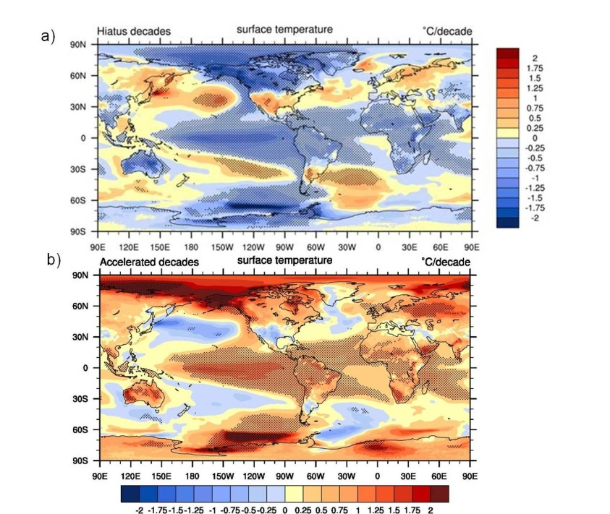
Externally forced and internally generated decadal climate variability associated with the Interdecadal Pacific Oscillation
Objective
Globally averaged surface air temperatures in some decades show rapid increases (accelerated warming decades) and in other decades there is no warming trend (hiatus decades).
Determine contributing factors to interplay between internally generated and externally forced climate variability
Approach
Choose accelerated warming and hiatus decades from CCSM4 RCP4.5 five member ensemble
Show that SST patterns for two sets of decades are mirror images of each other, with positive phase of the Interdecadal Pacific Oscillation (IPO) associated with accelerated warming decades, and opposite for hiatus decades.
SST trends in hiatus decades (top) and accelerated warming decades (bottom) showing opposite phases of the internally generated IPO in the Pacific
Impact
The deep ocean warms faster during hiatus decades compared to accelerated warming decades. Hiatus decades can last as long as 15 years in the model, with internally generated variability overwhelming warming from increasing GGHs.
Meehl, G.A., A. Hu, J.M. Arblaster, J. Fasullo, and K.E. Trenberth, 2013: Externally forced and internally generated decadal climate variability associated with the Interdecadal Pacific Oscillation, J. Climate, in press.

