Slide 1
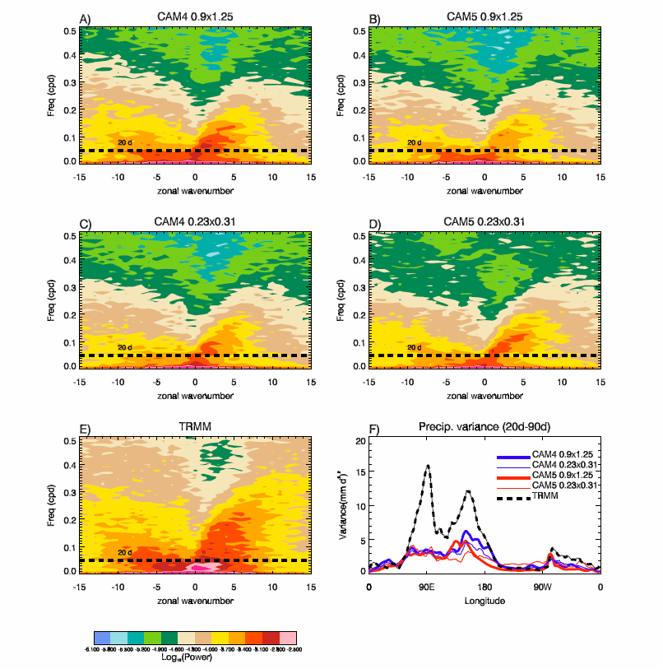
Exploratory high-resolution climate simulations using the Community Atmosphere Model (CAM)
Extended, high-resolution (0.23° latitude × 0.31° longitude) simulations with Community Atmosphere Model versions 4 and 5 (CAM4 and CAM5) are examined and compared with results from climate simulations conducted at a more typical resolution of 0.9° latitude × 1.25° longitude. Overall, the simulated climate of the high-resolution experiments is not dramatically better than that of their low-resolution counterparts. Improvements appear primarily where topographic effects may be playing a role, including a substantially improved summertime Indian monsoon simulation in CAM4 at high resolution.
Significant sensitivity to resolution is found in simulated precipitation over the southeast United States during winter. Some aspects of the simulated seasonal mean precipitation deteriorate notably at high resolution. Prominent among these is an exacerbated Pacific “double ITCZ” bias in both models. Nevertheless, while large-scale seasonal means are not dramatically better at high resolution, realistic tropical cyclone (TC) distributions are obtained. Some skill in reproducing interannual variability in TC statistics also appears.
(a)–(e) Zonal wavenumber–frequency power spectra of daily precipitation averaged from 10°S to 10°N for 1 Jan 1999–31 Dec 2004:
(a) CAM4 0.9 × 1.25, (b) CAM5 0.9 × 1.25, (c) CAM4 0.23 × 0.31, (d) CAM5 0.23 × 0.31, and (e) TRMM 3B42 observational estimate.
(f) Time mean bandpass-filtered (20–90 day) variance of precipitation for the same period averaged from 10°S to 10°N.
Bacmeister, J.T., M.F. Wehner, R.B. Neale, A. Gettelman, C.E. Hannay, P.H. Lauritzen, J.M. Caron, and J.E. Truesdale, 2014:
Exploratory high-resolution climate simulations using the Community Atmosphere Model (CAM). Journal of Climate, 27, 3073–3099,

