Slide 1
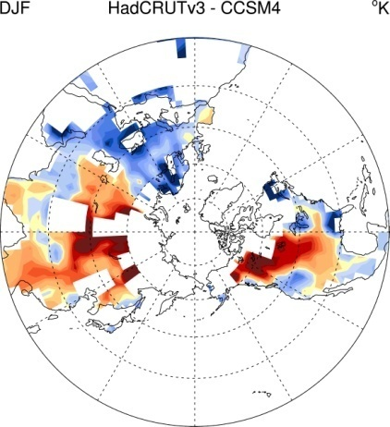
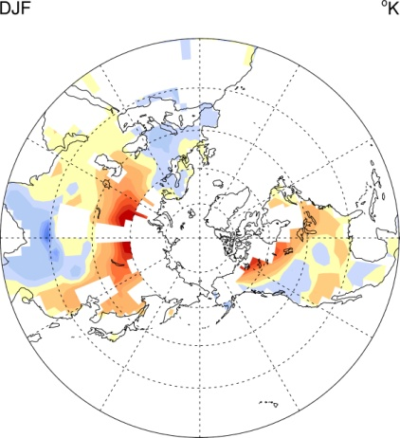
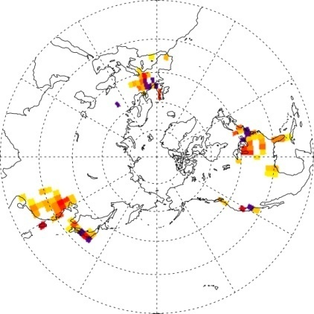
Energy Consumption and the Unexplained Winter Warming
over Northern Asia and North America
Objective
Because the total amount the human energy consumption is so small in comparison to greenhouse gases induced radiative forcing, its impact on global climate has been neglected previously. Here we study the impact of this human energy consumption on the unexplained winter warming pattern in the Northern Hemisphere using CAM3 and CCSM4.
The unexplained winter surface temperature trends in the last half-century (left plate) and the climate response (right plate) to heating from energy consumption in major metropolitan areas (middle plate) over the Northern Hemisphere.
Approach
CAM3 and CCSM4 are used as the primary tools for this study.
Two simulations using CAM3 were carried out with one including the human energy consumption, and the other on not.
CCSM4 20th century all forcing simulation and the CCSM4 1850 control run is also used to find the surface temperature trend difference between CCSM4 simulations and observations.
Impact
Our results suggest that although the human energy consumption will not change the global mean temperature, it does affect regional climate patterns. This energy usage may be responsible for the unexplained winter warming in North America and Asia in the observations.
This new source of forcing which has been largely ignored previously may impact significantly on future climate studies.
Zhang, G. J., M. Cai and A. Hu, 2012, Energy Consumption and the Unexplained Winter Warming over Northern Asia and North America, Nature Climate Change, doi:10.1038/NCLIMATE1803.

