Slide 1
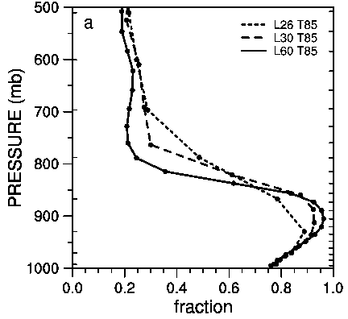
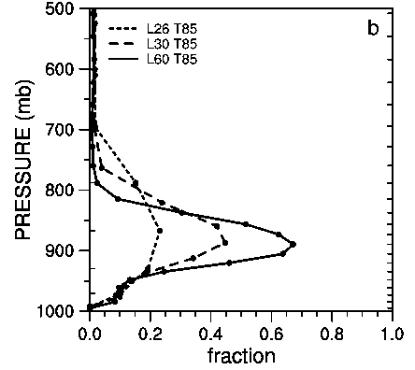
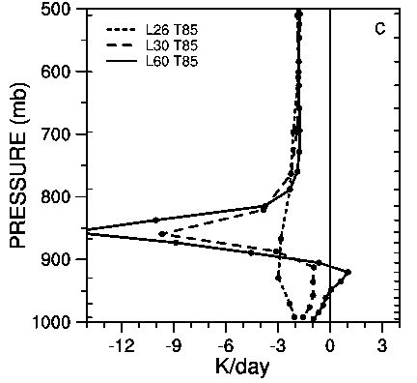
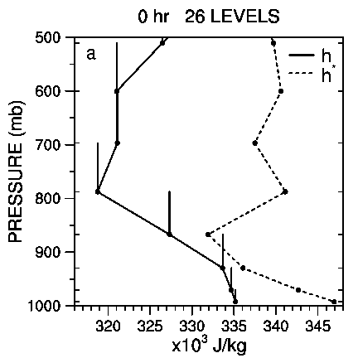
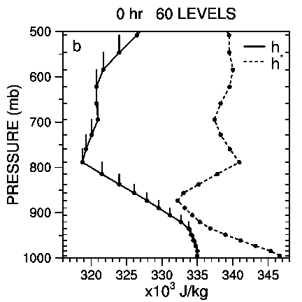
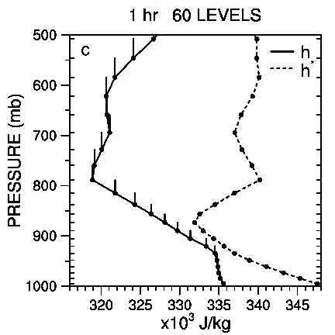
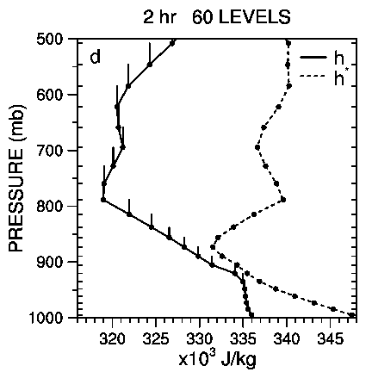
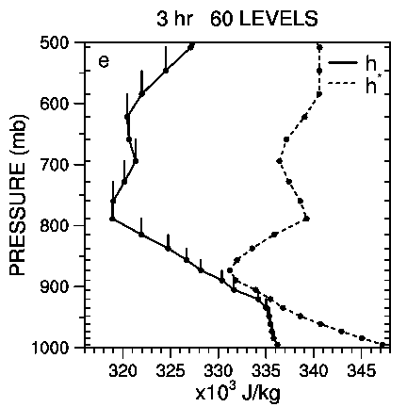
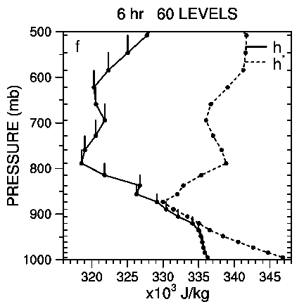
Dependence of APE simulations on vertical resolution with the Community Atmospheric Model, Version 3.
Objective
RELATIVE HUMIDITY
CLOUD
RADIATION
CCM3 has a very strong sensitivity to vertical resolution in which higher resolution produces an unrealistic atmospheric state. This is shown in the figures to the right in the subsidence region. The cause of this sensitivity is studied for the context of an aqua-planet.
Approach
The source of the sensitivity is studied by considering the evolution of the 60-level model starting from a state created by the 26-level model. The cause is shown to be the discrete approximations in the shallow convection. When the 60-level model is presented with an initial state interpolated from a 26-level model state, the columns are stable by the discrete test in the shallow convection (top middle figure to right), even though they are unstable when the discrete calculation is based on the coarser 26-level grid (top left figure).
The Planetary Boundary Layer parameterization pumps water vapor into the lower troposphere, low clouds increase to unrealistic levels and force strong longwave radiative cooling. This destabilizes the column until the discrete test is satisfied on the 60-level grid and the shallow convection becomes active again (sequence of remaining figures to right). However the simulated state is by then very different and unlike the earth's atmosphere. Similar unrealistic behavior has been seen in earth-like simulations with higher resolution.
.
Evolution of stability measure. Unstable when the vertical bar from the solid line ends to the right of the dashed line.
Impact
With the higher vertical resolution, the shallow convection parameterization requires the unreasonable states in order to become active and thus appears to be inaccurate at higher vertical resolution. Normally, numerical approximations are expected to be more accurate at higher resolution. That is the case for many of the other parameterizations and for the dynamical core. Thus the shallow convection parameterization should be improved or replaced to allow increased vertical resolution in the model. It was replaced in the next version of the CAM.
D. L. Williamson, 2013: Dependence of APE simulations on vertical resolution with the Community Atmospheric Model, Version 3. J. Meteor. Soc. Japan, 91A, doi:10.2151/jmsj.2013-A08.

