Slide 1
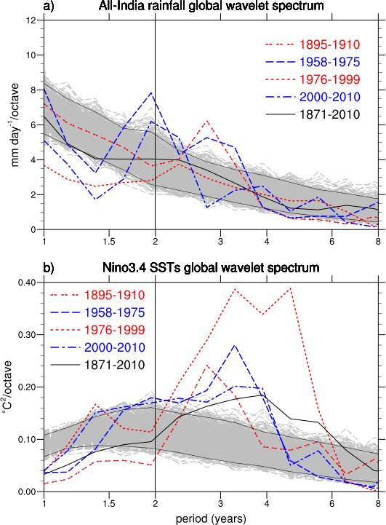
Decadal variability influences year-to-year climate fluctuations in the tropical Indo-Pacific region
Global wavelet
spectra for the
Indian monsoon
(top) and ENSO
(bottom) with
vertical line at
the biennial 2
year period
showing a
larger amplitude
TBO for decadal
periods of negative
IPO (blue lines),
and weaker TBO
for positive IPO
(red lines)
Objective
Determine why the Indo-Pacific climate system, encompassing the Indian monsoon and ENSO, is more biennial during certain decades than others. That is, what determines the strength of the tropospheric biennial oscillation (TBO) with associated predictability of the tropical interannual climate system on decadal timescales
Approach
Analyze observations of sea surface temperature (SST) and Indian monsoon rainfall, and relate the strength of the TBO to the phase of the Interdecadal Pacific Oscillation (IPO)
Identify decadal periods when the IPO is positive (somewhat warmer than normal SSTs in the eastern tropical Pacific) and negative, and connect to the TBO
Impact
During decades of positive IPO (from the late-1970s to the late-1990s), the Indo-Pacific climate system was less biennial and the TBO was weak, and the opposite after the late 1990s with corresponding improved predictability.
Meehl, G.A., and J.M. Arblaster, 2012: Relating the strength of the tropospheric biennial oscillation (TBO) to the phase of the Interdecadal Pacific Oscillation (IPO). Geophys. Res. Lett., doi:10.1029/2012GL053386.

