Slide 1
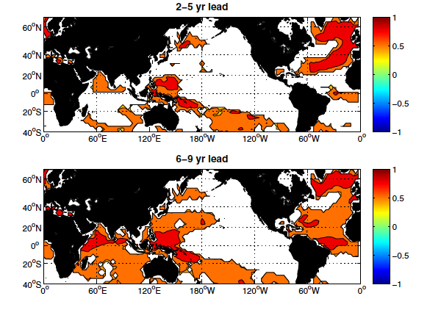
Decadal Predictions with CCSM4
Objective
The general goal is to explore possibility of making skillful decadal predictions with initialized climate model.
Average of correlation coefficient distribution for 15 hindcast initial conditions from 1961-2005. Only those correlation scores that exceed the statistical reference forecast at the 90% confidence level are plotted.
Approach
10-member initialized CCSM4 experiments starting from year 1961, 1966, …, 2006, following the CMIP5 protocol
CLIVAR (2011) bias correction scheme
Impact
This study demonstrates that tremendous decadal predictive skills in the SPG region can be achieved by initializing the ocean model.
Karspeck,A., S. Yeager, G. Danabasoglu, and H. Teng, 2014: An evaluation of experimental decadal predictions using CCSM4, Clim Dyn, DOI: 10.10067/s00382-014-2212-7
This project is co-funded by NSF, NOAA and DOE.

