Slide 1
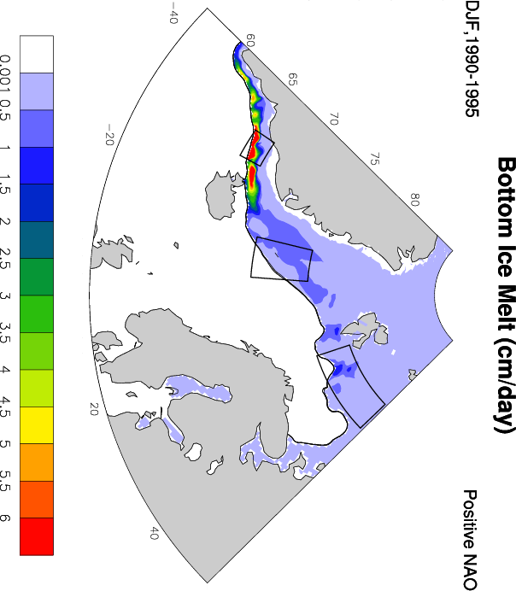
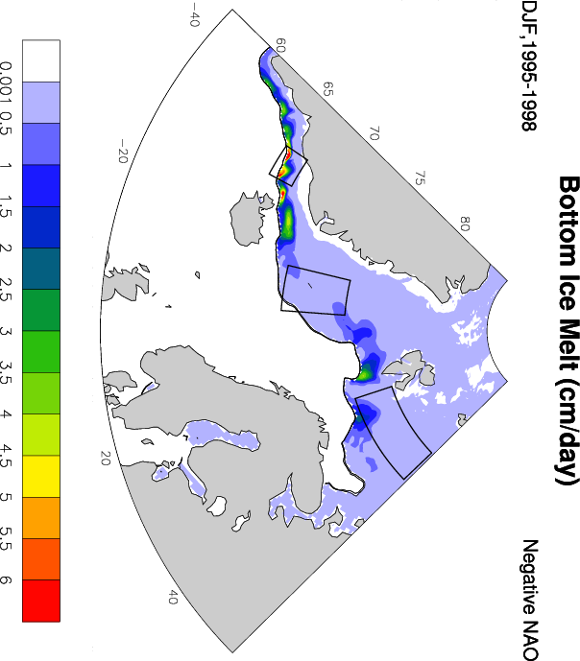
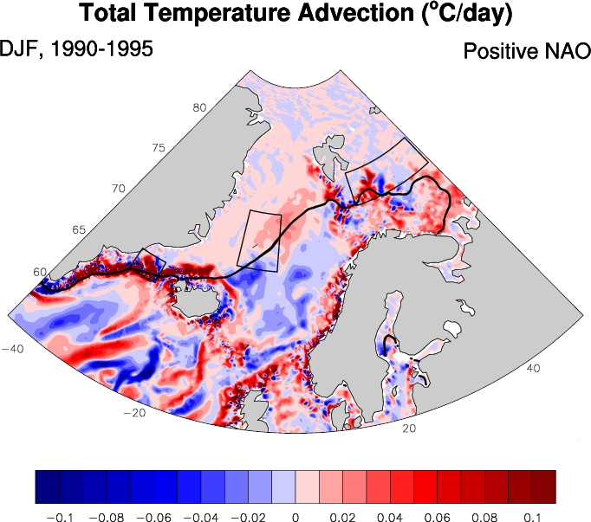
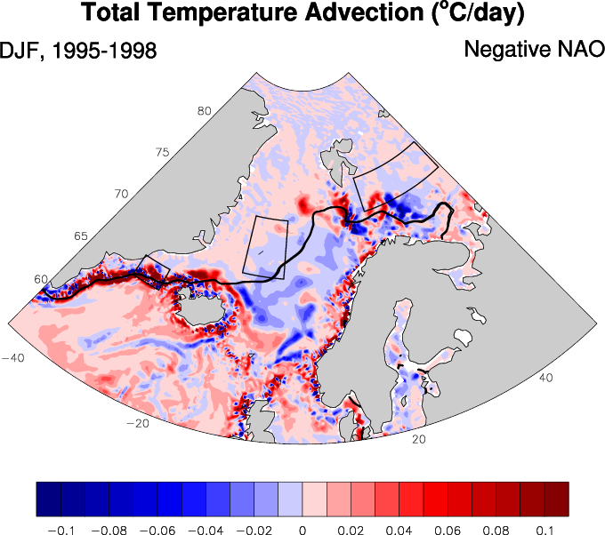
Ice-ocean-atmosphere interaction in the North Atlantic Marginal Ice Zone
Objective
Assess the role of the the ocean heat advection and surface net heat fluxes on the bottom ice melt in the Marginal Ice Zone (MIZ) on interannual scales.
Bottom Ice Melt (cm/day)
Positive NAO
Negative NAO
The Barents Sea
The Nordic Seas
The Irminger Sea
Approach & Results
0.4° Coupled ocean-ice POPCICE simulation forced with NCEP/NCAR atmospheric reanalysis;
Composites of the mean ice, ocean and atmospheric state during the two NAO phases in the 1990s to evaluate the changes in the atm-ice-ocean interaction;
The bottom ice melt is dominating the top ice melt signifying the role of the ice-ocean exchange for the ice thermodynamics in this area; Ocean advection anomalies are closely related to anomalous bottom ice melt rates (see the figure);
Regional ocean mixed layer heat budget estimate shows that the contribution of the temperature advection is of the same order of magnitude although always smaller than the surface net heat flux terms and that entrainment of heat from the deeper ocean may play a key role.
Total Temperature Advection (°C/day)
Negative NAO
Positive NAO
Impact
Our ocean heat budget analysis provides improved understanding of factors controlling ice edge variability which is valuable for further ice-ocean model development as well as better understanding of the observed ice area changes.
Ivanova, D.P., J.L. McClean, and E.C. Hunke (2012), Interaction of ocean temperature advection, surface heat fluxes and sea ice in the marginal ice zone during the North Atlantic Oscillation in the 1990s: A modeling study. J. Geophys. Res.-Oceans, 117, C02031, doi:10.1029/2011JC007532

