Slide 1
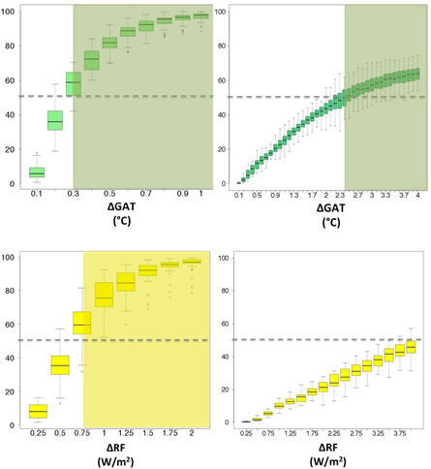
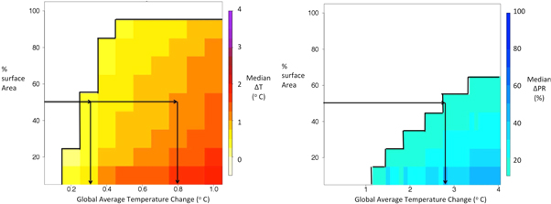
Sensitivity of regional climate to global temperature and forcing
Objective
We want to link magnitude of global characteristics of scenarios (global average temperature, global radiative forcing) to magnitude of regional climate change (average temperature and precipitation change at a grid-box scale) in order to determine on the one hand how far apart should scenarios be to justify investing in computational costs to run them through expensive coupled climate models (i.e., how far is far enough), on the other hand to determine how one scenario can be used to approximate another (i.e., how close is close enough).
Multi-model distributions, in the form of boxplots, of the fraction of Earth's land area showing a statistically significant change (at the 0.05 level) in annual average surface temperature (left panels) and precipitation (right panels) for different levels of ΔGAT (top) or ΔRF (bottom). Distributions consist of 29 values, one for each of the models available in the CMIP5 archive running the 1% CO2 increase per year experiment and the pre-industrial control experiment. The latter is used for determining significance of the changes.
Approach
We use CMIP5 simulations and specifically designed NCAR/DOE CESM1-CAM5 experiments to determine differential impacts at the grid-box levels (in terms of temperature and precipitation changes that are statistically significant compared to internal variability) of scenario differences, measured as a function of their global characteristics like global average temperature change or global radiative forcing levels. Thus, we quantify the significance and magnitude of regional changes for fractional increments of global characteristics, and by doing that we can answer questions like “What fraction of the land surface experiences significant additional warming for an increase in global average temperature of 0.1°C (or 0.2/3….etc.) or for an increase in RF of 0.25 Wm⁻² (0.5,1…etc.)?” We also characterize changes in precipitation, and magnitude of change, besides statistical significance, for both variables. We test the robustness of our findings to the type of scenario (idealized or realistic, for a given magnitude of global change), to the spatial resolution of the analysis, to the presence of baseline warming.
Changes in annual average surface temperature (left) and precipitation (right) over land for different values of global average temperature change. The height of the colored bars indicates the fraction of land surface affected by statistically significant changes (by at least half of the 29 models in the ensemble). Colors indicate the distribution of the magnitude of change, expressed as the median change of those models showing a significant change.
Impact
This work can inform the choice of mitigation targets, by quantifying the differential impacts that a target within a few tenths of a degree of another is expected to cause; designing future scenario experiments, by determining how far apart different scenarios have to be to cause different regional climate changes over a significant fraction of the Earth’s surface; choosing the correct type of climate information (climate model simulations) to determine impacts under alternative scenarios, by showing how regional climates under scenarios that are relatively close should be considered statistically different or indistinguishable.
Tebaldi C, O’Neill BC and Lamarque JF 2015, Sensitivity of regional climate to global temperature and forcing, Environmental Research Letters, doi:10.1088/1748-9326/10/7/074001

