Slide 1
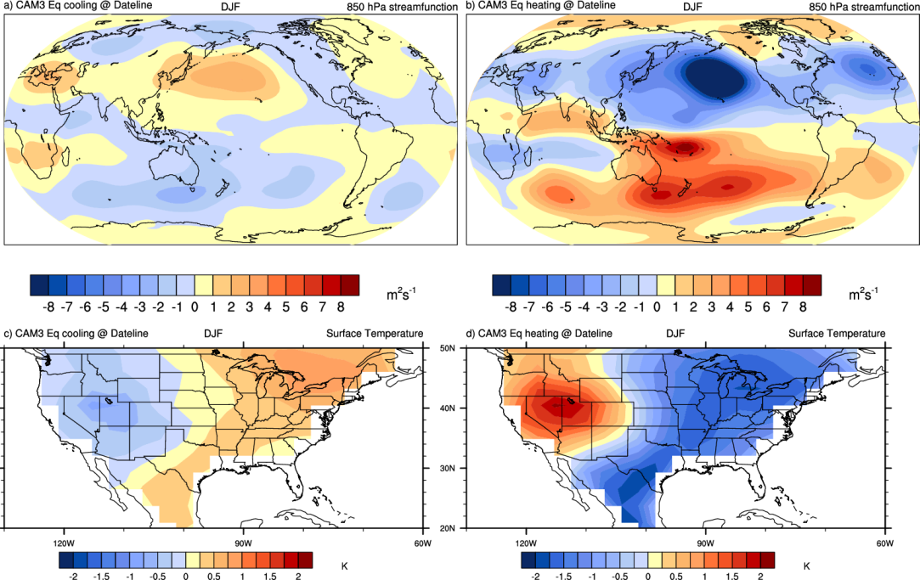
Disappearance of the southeast U.S. “warming hole” in the
early 21st century is tied to the tropical Pacific
Objective
Understand why the cooling trend in the southeast U.S. from about 1950-2000, the “warming hole”, changed to a warming trend there after 2000
Approach
The phase of the Interdecadal Pacific Oscillation (IPO) changed from above-normal tropical Pacific sea surface temperatures (SSTs) to below-normal SSTs around 2000
Use an atmosphere-only model with a negative specified convective heating anomaly associated with these cooler SSTs and reduced precipitation over the equatorial central Pacific to show the effects of the IPO on large-scale atmospheric circulation changes that affect U.S. temperatures
A “warming hole” over the southeast U.S. (lower right) is produced by atmospheric circulation anomalies (top right) with the positive phase of the IPO, while the pattern reverses and the warming hole disappears with the negative phase of the IPO (left panels) in the atmosphere-only model sensitivity experiments
Impact
The negative phase of the internally-generated IPO in the tropical Pacific after 2000 produced changes in atmospheric circulation that made the southeast U.S. warming hole disappear, pointing to the importance of naturally-occurring Pacific decadal variability in affecting regional U.S. temperature trends on decadal timescales
Meehl, G.A., J.M. Arblaster, and C.T.Y. Chung, 2015: Disappearance of the southeast U.S. “warming hole” with the late-1990s transition of the Interdecadal Pacific Oscillation. Geophys. Res. Lett., doi:10.1002/2015GL064586.

