Slide 1
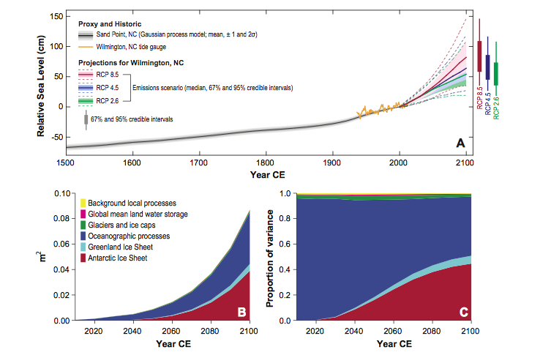
Past and future sea-level rise along the coast of North Carolina, USA
Objective
Using proxy data, tide gauge records, process models and expert elicitation we want to account for all sources of uncertainty in describing past and current SLR in North Carolina and project in full probabilistic terms future changes and their impact on storm surge heights.
Approach
Tide gauge and proxy data are fitted to a Gaussian Process statistical model that represents sea level as the sum of millennial, centennial and decadal processes. Rates of relative sea level change are obtained from the GP model with full uncertainty ranges. We then use process models of ocean and land-ice behavior, statidtical models of local sea-level processes, expert elicitation on ice-sheet behavior and expert assessment of the overall sea-level response to obtain probabilistic future projections under three RCPs and compute their impacts on water height extremes.
Past, current and projected sea level rise in Wilmington, NC (upper panel), and its sources of variability in absolute (bottom left) and relative (bottom right) terms.
Impact
The fully probabilistic representation of the uncertainty in projections of SLR under three different scenarios, and our characterization of how the mean sea level change translates in changes in the statistics of extremes can inform adaptation measures along the coast of the state.
Kopp, RE, Horton BP, Kemp, AC and C Tebaldi, 2015: Past and future sea-level rise along the coast of North Carolina, USA. Climatic Change, doi:10.1007/s10584-015-1451-x

