Slide 1
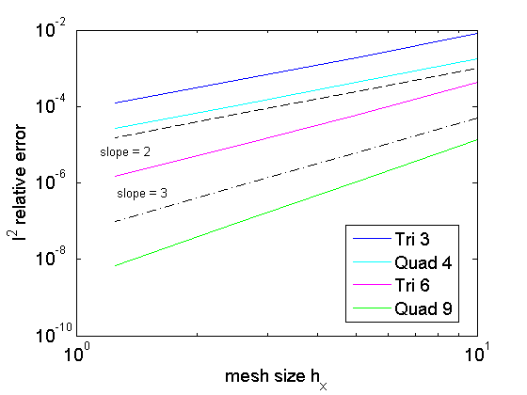
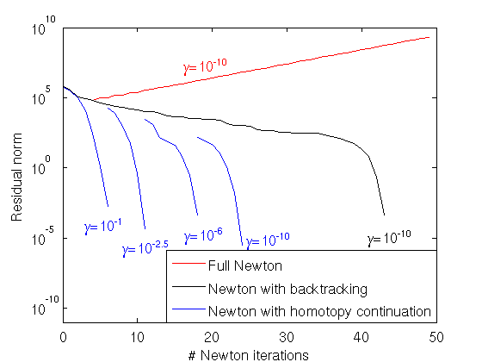
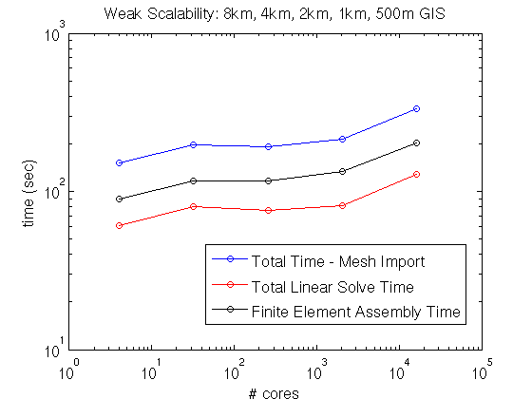
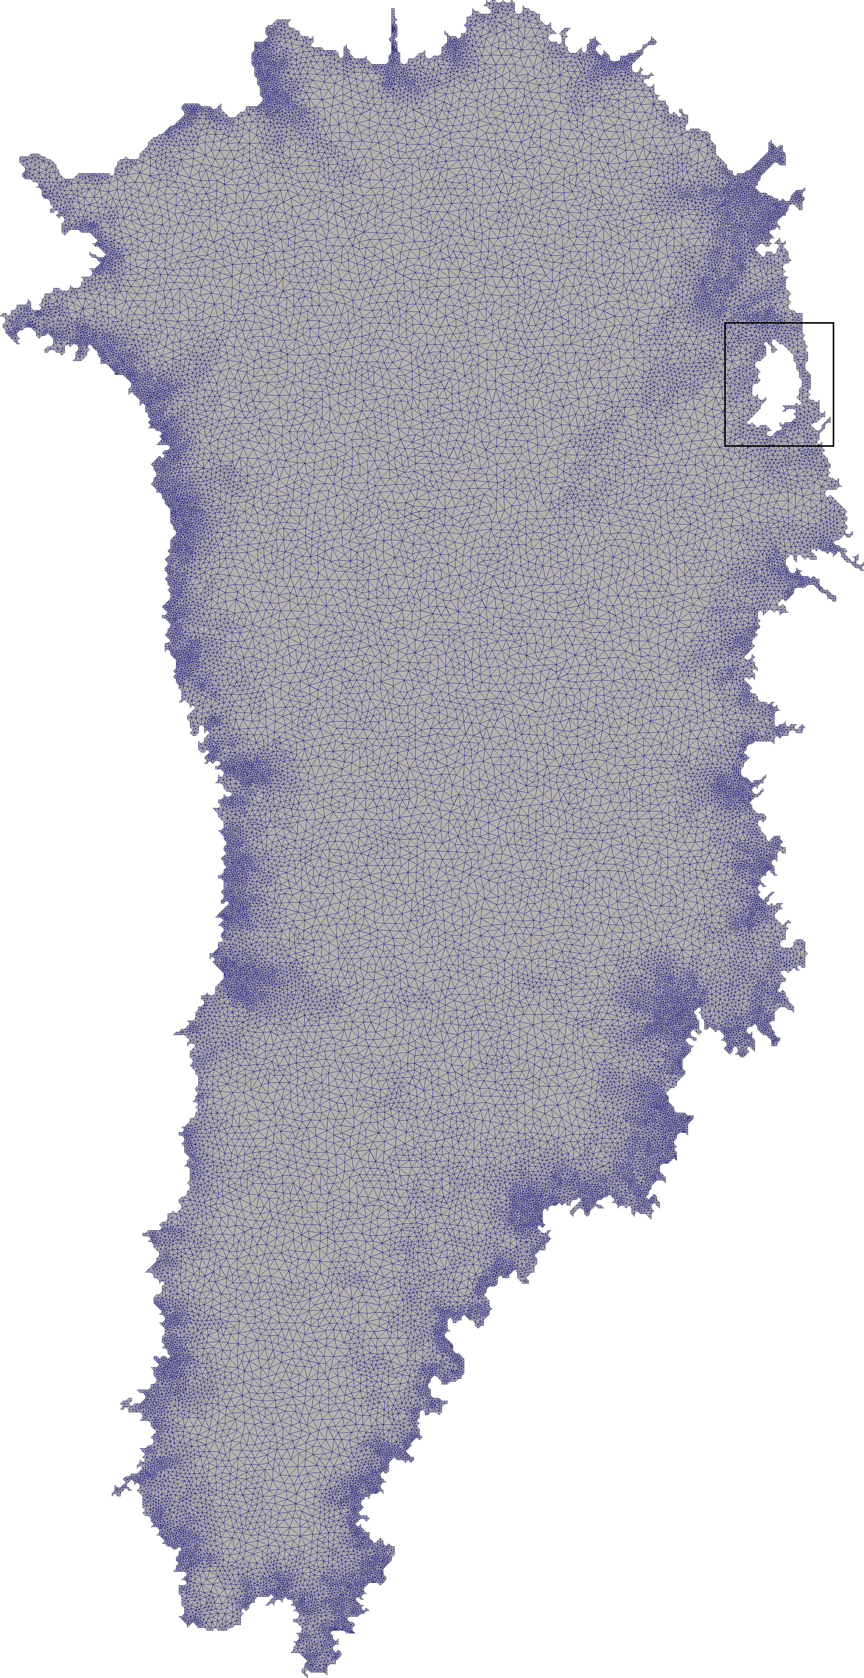
Albany/FELIX: a parallel, scalable and robust, finite element, first-order Stokes approximation ice sheet solver built for advanced analysis
Problem
The climate community is lacking an unstructured grid, scalable, robust and efficient first-order (FO) Stokes flow solver with advanced analysis capabilities.
Approach
Using the component-based approach to building new application codes and the Trilinos libraries, we have written a new parallel, scalable and robust finite element FO Stokes solver for ice flow, known as Albany/FELIX. This process has resulted in the following new contributions to the field of ice sheet modeling:
(1) Derivation of new tests cases using the method of manufactured solutions for simplified 2D forms of the FO Stokes equations (top right).
(2) Development of a homotopy continuation algorithm that yields a robust nonlinear Newton solver (middle right).
(3) Development of a new algebraic multilevel preconditioner based on semi-coarsening that yields a scalable linear solver (bottom right).
Impact
New parallel, scalable and robust finite element unstructured grid FO Stokes diagnostic flow solver, to be coupled to earth system models for prognostic runs.
I. K. Tezaur, M. Perego, A.G. Salinger, R.S. Tuminaro, S.F. Price. Albany/FELIX: a parallel, scalable and robust finite element first-order Stokes approximation ice sheet solver built for advanced analysis. Geosci. Model Dev. 8 1-24, 2015.

