Slide 1
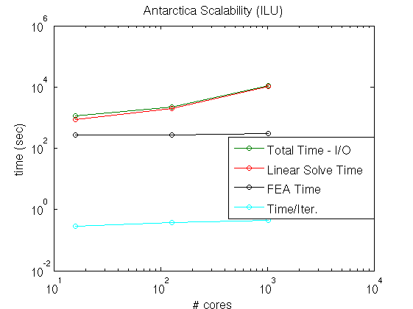
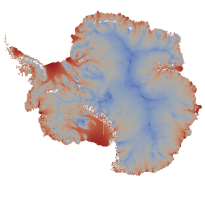
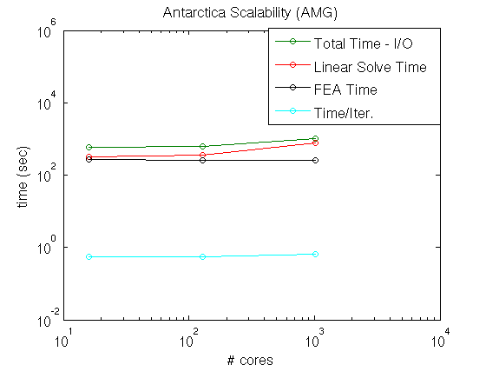
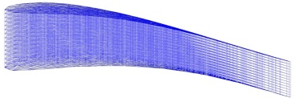
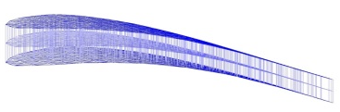


Scalability of the Albany/FELIX dynamical core for
large-scale Greenland and Antarctica simulations
Problem
Outlet glaciers, ice streams, and ice shelves lead to ill-conditioned linear systems upon discretization. For large-scale, high-resolution ice sheet simulations, robust and scalable linear solvers are needed.
Approach
We study the performance of two preconditioners for the linear systems arising from the discretization of the governing equations in the Albany/FELIX first-order Stokes approximation solver. The first is based on ILU and the second, newly developed, is based on algebraic multigrid (AMG) and the idea of semi-coarsening (bottom).
For Antarctic ice sheet simulations, performance of the ILU-based preconditioner deteriorates with problem size whereas the AMG preconditioner maintains scalability (right). A strong scaling study on a Greenland ice sheet problem demonstrates good overall scalability of the Albany/FELIX code.
Impact
Demonstrated scalability and robustness of the Albany/FELIX dynamical core on realistic, large-scale Greenland and Antarctic ice sheet problems.
Tezaur, I., R. Tuminaro, M. Perego, A. Salinger, S. Price. On the scalability of the Albany/FELIX first-order Stokes approximation ice sheet solver for large-scale simulations of the Greenland and Antarctic ice sheets, Procedia Computer Science, ICCS 2015 International Conference on Computational Science 51 (2015) 2026-2035. doi: 10.1016/j.procs.2015.05.467.
…
Algebraic Structured MG
Algebraic Structured MG
Unstructured AMG
Unstructured AMG

