Slide 1
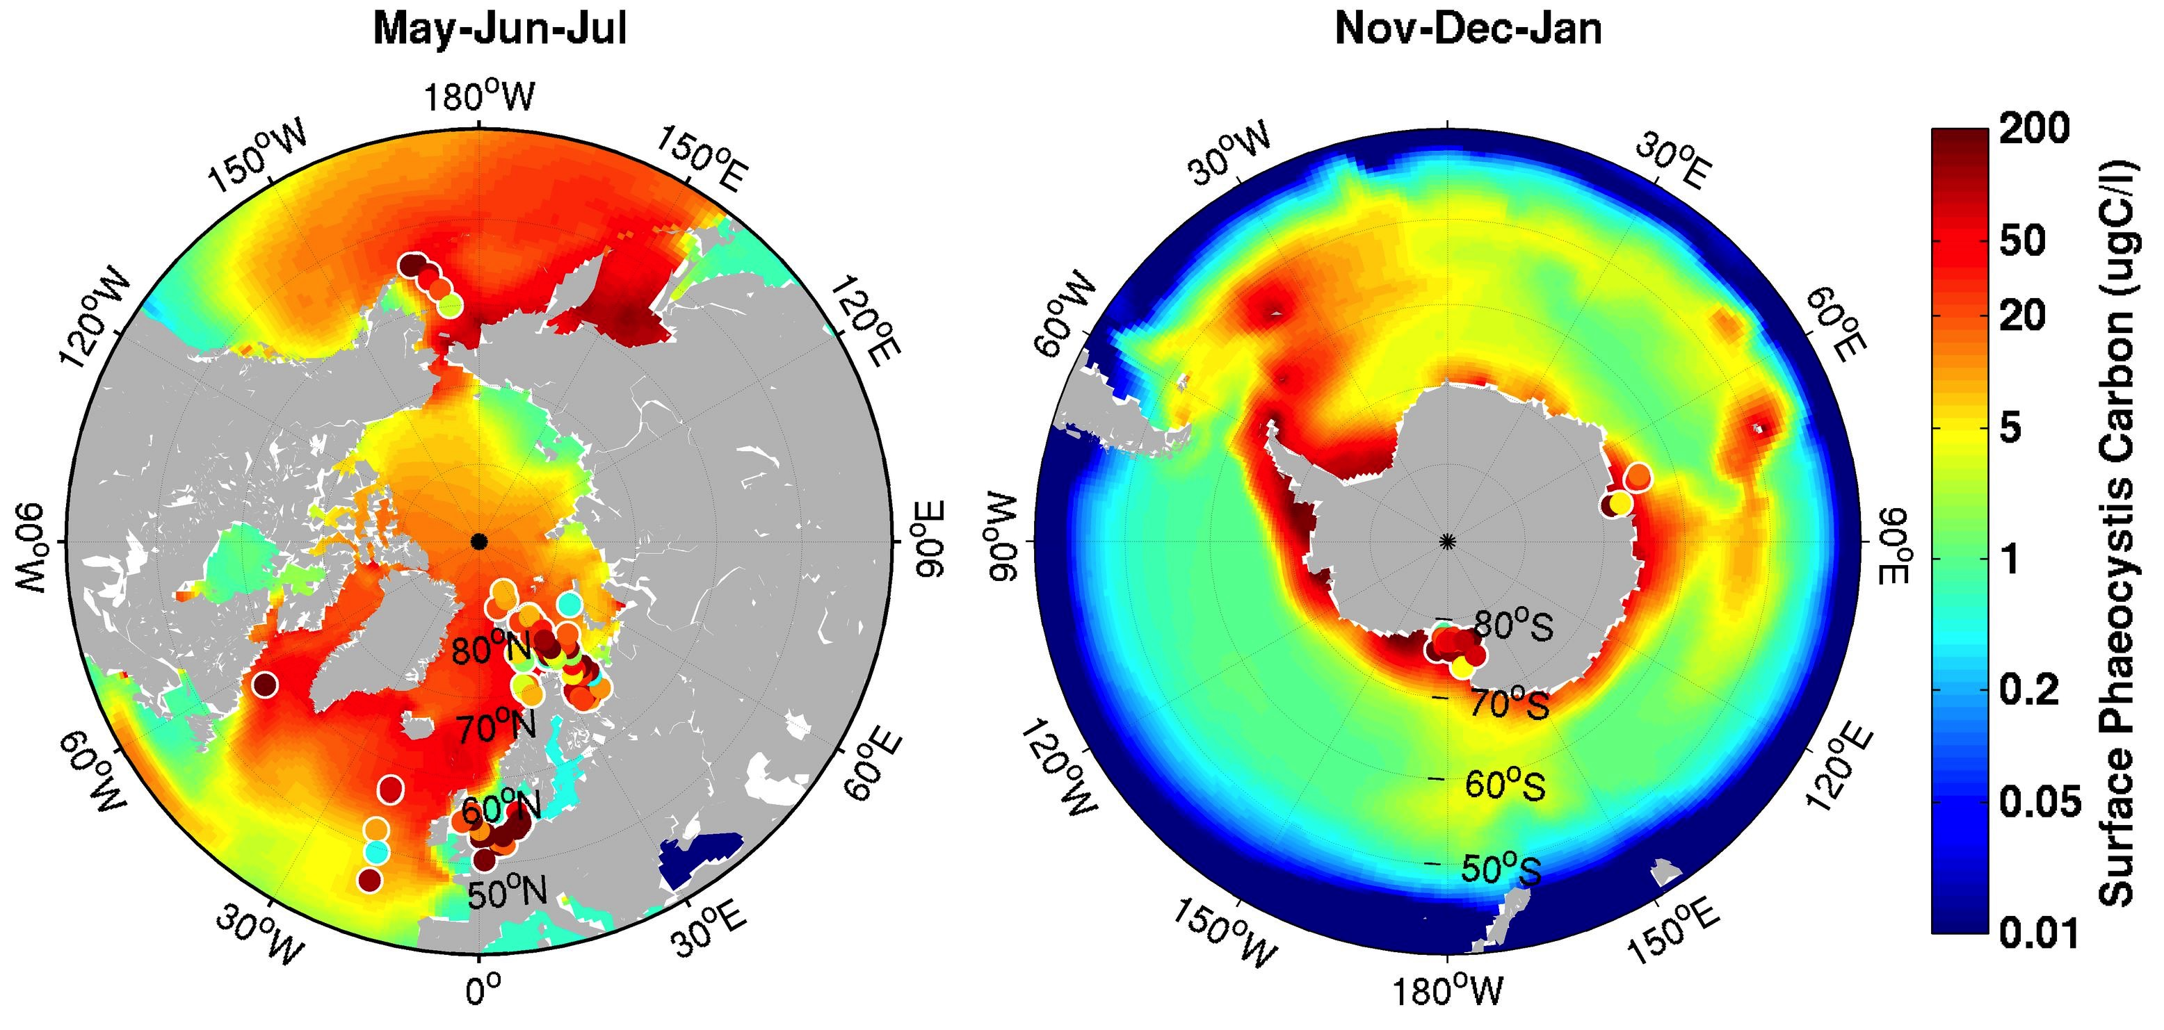
Global Ocean Organosulfur Cycles: DMS in ACME
Objective
Dimethyl sulfide acts as a thermostat on climate but regional effects depend on fine scale eco-structural aspects of the marine system, e.g. phytoclass sulfur content, various stressors plus microbial demand and volatile yield. ACME now has the biochemical resolution to assess flux shifts over the era of global change.
Below: Development and benchmarking of Phaeocystis, a
major polar sulfur producer. Cyanobacteria and others also
inserted and tested. Bioinfluence strong on regional
CCN, with sensitivity of Arctic sea ice and cloud structure.
Approach
ACME and MPAS-O schemes tested
Production alongside protein synthesis
Carry phytoS levels, DMSP, stressors, bacterial uptake as f(sulfur demand)
Runs show sea ice depends on DMS
Now linking plankton to cloud classes
Impact
Latest estimates: DMS controls 10-20 W/m² of RSW over the Southern Ocean and large quantities elsewhere. But in the next century, stratification will shift ecostructures and surfactant trace gas transfer barriers.
Latest DOE ESM Chemistry@Interfaces Working Group Pubs: Wang, S., Elliott, S., Maltrud, M., Cameron-Smith, P. 2015. Influence of dimethyl sulfide on marine ecosystems and the carbon cycle. Journal of Geophysical Research –Biogeosciences, in prep. Wang, S., Elliott, S., Cameron-Smith, P., Maltrud, M. 2015. Influence of explicit Phaeocystis parameterizations on global distributions of marine dimethyl sulfide. Journal of Geophysical Research –Biogeosciences, in press. McCoy, D. with Burrows, S., Elliott, S. and 4 others. 2015. Natural aerosols explain seasonal and spatial patterns of Southern Ocean cloud albedo. Science Advances 6, 10.1126/sciadv.1500157. Elliott, S. 2015. Comment on marine emissions and atmospheric distributions of halocarbons and DMS, Atmospheric Chemistry and Physics Discussions 15, C5070-C5073.

