Slide 1
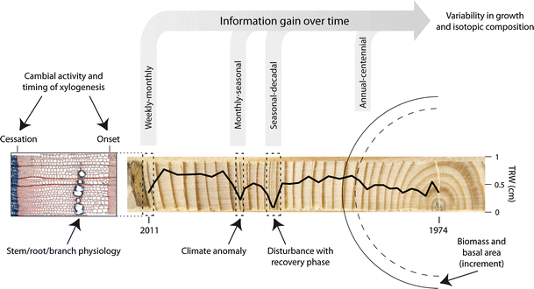

Tree rings - Linking the carbon cycle and climate
Decadal-centennial constraints for Earth System Models
Information content of tree increment cores can provide a constraint on Land Surface Models with respect to:
growth phenology
forest productivity
CO₂ fertilization
forest disturbances
vegetation model evaluation
Increment cores can augment short term metrics like eddy covariance towers at seasonal, inter-annual and decadal-centennial timescales
Babst F, Alexander MR, Szejner P, Bouriaud O, Klesse S, Roden J, Ciais P, Poulter B, Frank D, Moore DJP, Trouet V (2014) A tree-ring perspective on the terrestrial carbon cycle Oecologia 176 (2), 307-322 OECO-D-14-00512
DOE Regional and Global Climate Modeling DE-SC0016011

