Slide 1
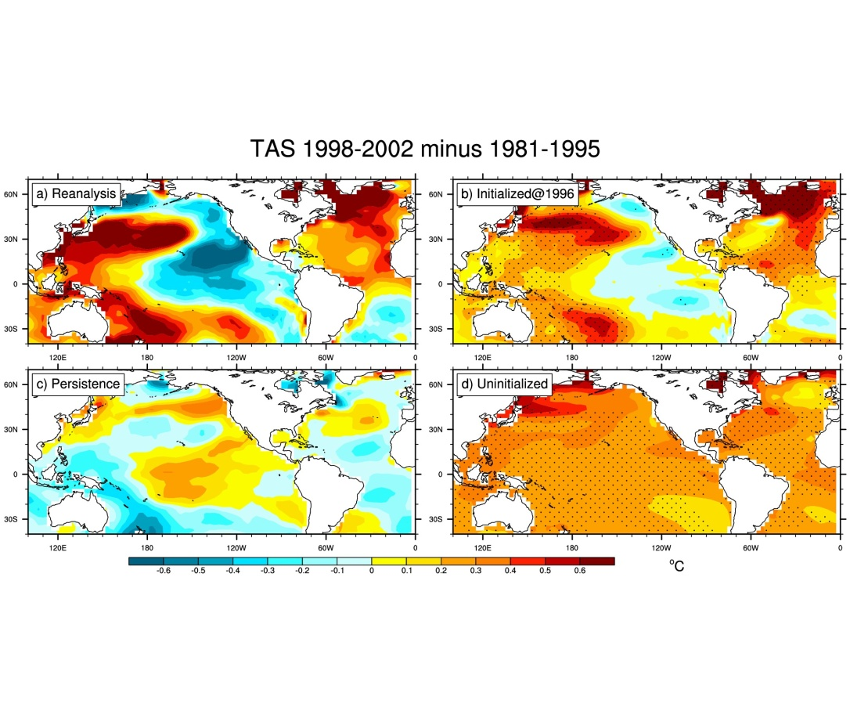
Could we have predicted the early-2000s hiatus of global warming in the 1990s?
Objective
Determine if climate models could have predicted, in the 1990s, the recent slow-down of global warming, the “early-2000s hiatus”, using either uninitialized or initialized climate models
Approach
All 262 ensemble members from uninitialized CMIP5 models are analyzed to show 10 members simulate the current observed hiatus when internal variability in the models happens, by chance, to sync up with the observed internal variability, but there is no predictive value
The set of 16 initialized CMIP5 models is analyzed for predictions of the hiatus made from the mid-1990s
Surface air temperature patterns for prediction of the IPO transition in the late 1990s. The observed negative IPO pattern (a) is simulated in a 3-7 year average prediction initialized in 1996 for years 1998-2002 (b). This initialized prediction is closer to the observations than either a persistence prediction (c) or a free-running uninitialized prediction (d); stippling indicates 10% significance.
Impact
If the recent methodology of initialized decadal climate prediction could have been applied in the mid-1990s using the CMIP5 multi-models, both the negative phase of the IPO in the early 2000s as well as the hiatus could have been simulated, with the multi-model average performing better than most of the individual models.
Meehl, G.A., H. Teng and J.M. Arblaster, 2014: Climate model simulations of the observed early-2000s hiatus of global warming. Nature Climate Change, doi:10.1038/NCLIMATE0549.

