Slide 1
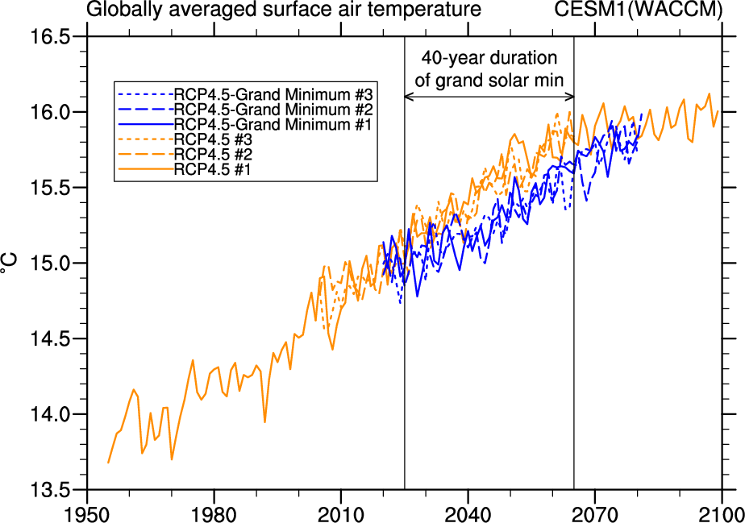
Could a future “Grand Solar Minimum” like the Maunder Minimum stop global warming?
Objective
Determine whether a future decrease in total solar irradiance comparable to the Maunder Minimum during the Little Ice Age could stop global warming in the 21st century
Approach
A future Maunder Minimum-type grand solar minimum, with total solar irradiance reduced by 0.25% over a 50 year period from 2020 to 2070, is imposed in a future climate change scenario experiment (RCP4.5) using, for the first time, a global coupled climate model that includes ozone chemistry and resolved stratospheric dynamics (WACCM).
Time series of globally averaged surface air temperature anomalies (°C) relative to the 1986-2005 reference period for the CESM1(WACCM) standard RCP4.5 simulations (orange lines) and the grand solar minimum experiment (blue lines). The duration of the grand solar minimum experiment is indicated from 2025-2065.
Impact
A future grand solar minimum could slow down but not stop global warming.
.
Meehl, G.A., J.M. Arblaster, and D.R. Marsh, 2013: Could a future “Grand Solar Minimum” like the Maunder Minimum stop global warming? Geophys. Res. Lett., in press.

