Slide 1
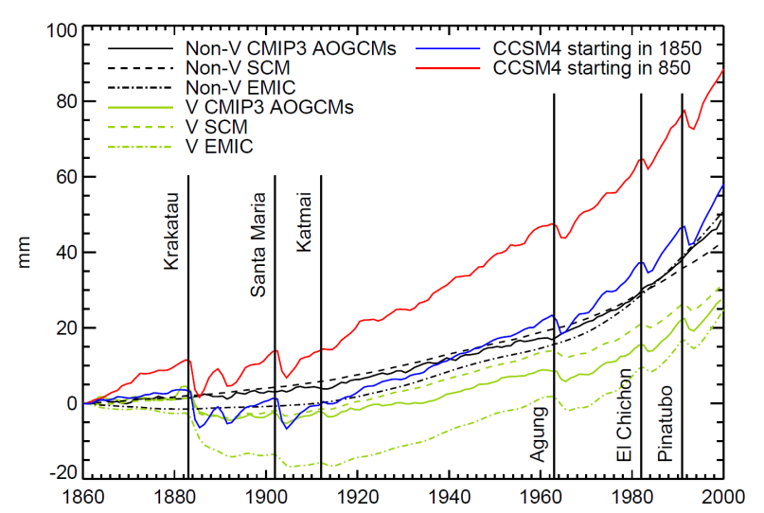
Climate models without pre-industrial volcanic forcing underestimate historical ocean thermal expansion
Objective
Episodic explosive volcanic eruptions are a natural part of the climate system, but are often omitted from AOGCM pre-industrial spin-up and control experiments. This omission imposes a negative bias on ocean heat uptake in simulations of the historical period. Here we study the impact of this omission on the 20th century simulations using CMIP3 models, simple climate models, Earth system model of intermediate complexity, and CCSM4.
Global-mean sea-level rise (mm) due to thermal expansion relative to 1860
Approach
Impact
We test this using a pair of experiments carried
out with the NCAR CCSM4 AOGCM, which was spun up without volcanic forcing. One experiment is 1150 years long, using historical forcings for 850–2000 including volcanic forcing (zero or negative with respect to the spin-up); the other is 150 years, for 1850–2000. Then we used simple models to test the volcanic forcing by performing long integrations which is not easy to do using AOGCM.
In models of a range of complexity, we find that global-mean sea-level rise due to thermal expansion during the last 150 years is consequently underestimated by 5–30 mm, which is a substantial proportion of the model-mean of 50 mm in CMIP3 AOGCMs with anthropogenic forcing only, and is therefore important in accounting for 20th-century sea-level rise. We test and recommend a procedure for removing this bias in the future simulation of the 20th century sea level rise.
Reference:Gregory, J. M., D. Bi, M. A. Collier, M. R. Dix, A. C. Hirst, A. Hu, M. Huber, R. Knutti, S. J. Marsland, M. Meinshausen, H. A. Rashid, L. D. Rotstayn, A. Schurer, J. A. Church, 2013, Climate models without pre-industrial volcanic forcing underestimate historical ocean thermal expansion, Geophys. Res. Lett., doi:10.1029/2013GL055496, in press.

