Slide 1
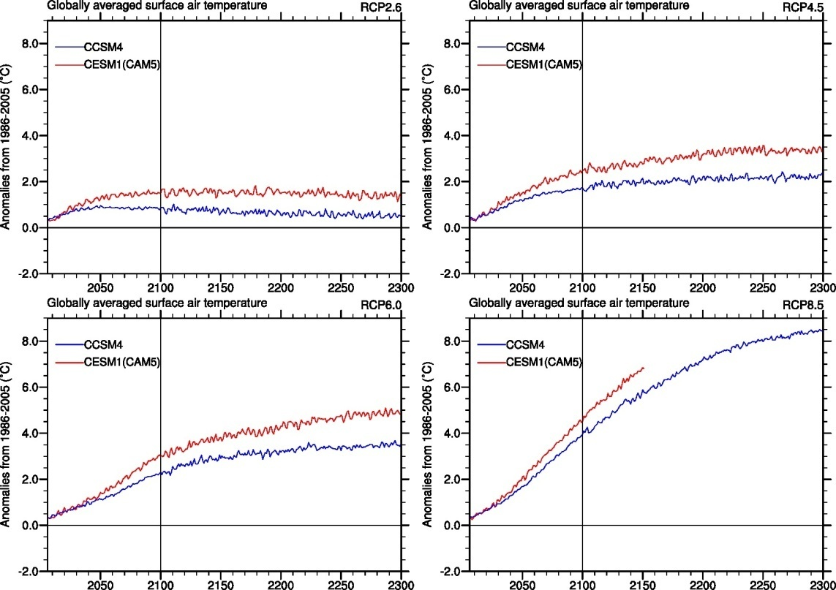
Climate change projections in CESM1(CAM5) compared to CCSM4
Objective
Document the simulations of future climate projections with CESM1(CAM5) and contrast them to results from CCSM4
Approach
Analyze the four RCP scenarios with CESM1(CAM5)
Equilibrium climate sensitivity of CESM1(CAM5) is 4.10°C, which is higher than the CCSM4 value of 3.20°C.
The transient climate response is 2.33°C, compared to the CCSM4 value of 1.73°C
Time series of annual globally averaged surface air temperature anomalies (relative to 1986-2005 base period, °C) for CESM1(CAM5) compared to CCSM4 for ensemble mean RCP future climate simulations.
Impact
Even though CESM1(CAM5) includes both the direct and indirect effects of aerosols (CCSM4 had only the direct effect), the overall climate system response including forcing and feedbacks is greater in CESM1(CAM5) compared to CCSM4
Meehl, G.A., W.M. Washington, J.M. Arblaster, A. Hu, H. Teng, J.E. Kay, A. Gettelman, D.M. Lawrence, B.M. Sanderson, and W.G. Strand, 2013: Climate change projections in CESM1(CAM5) compared to CCSM4. J. Climate, doi: 10.1175/JCLI-D-12-00572.1, in press.

