Slide 1
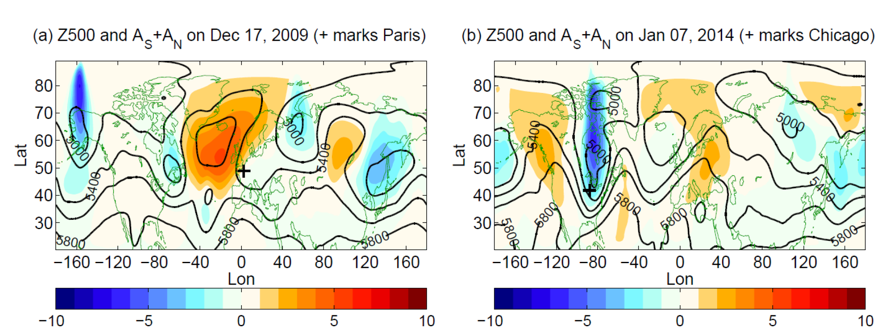
Local Finite-Amplitude Wave Activity as an Objective Diagnostic of Midlatitude Extreme Weather
Objective
Climate extremes are governed by different dynamics from the mean state, entailing an innovative theoretical framework and metrics for their quantification and understanding.
Develop and demonstrate the concept of finite-amplitude wave activity to three dimensions to account for the regional circulation associated with extremes and their variations under a changing climate.
Approach
Defined a local finite-amplitude wave activity (LWA) based on 500 hPa geopotential height, using a line integral transformation, instead of an area integral transformation
Apply LWA to capture the circulation features associated with the midlatitude weather extremes such as heat waves and cold snaps and to discern the cyclonic circulations from the anticyclonic ones by partitioning LWA into the southern and northern components to detect climate change signals.
Schematics illustrating the definition of local finite-amplitude wave activity. The northward (southward) line integral of q’=q-Q gives the northward (southward) or anticyclonic (cyclonic) local wave activity A_{N} (A_{S})
500-hPa geopotential height (contours) and the corresponding southern plus northern wave activity, A_{S}+A_{N} for cold air outbreaks in (a) western Europe on UTC 0000 17, 2009 and (b) in North America on 0000 UTC Jan. 2014
Impact
Found no hemispheric-scale increase in wave amplitude using LWA during the period of the drastic Arctic sea ice loss; the increase of wave activity is only regional in scale.
LWA engenders a more conservative and intuitive budget analysis linking its tendency toward temperature advection and diabatic heating.
Chen G, J Lu, DA Burrows, and LR Leung, 2015. “Local Finite-Amplitude Wave Activity as an Objective Diagnostic of Midlatitude Extreme Weather.” Geophysical Research Letters, DOI: 10.1002/2015GL066959.
Notes:
http://www.pnl.gov/science/highlights/highlights.asp?division=749

