Slide 1
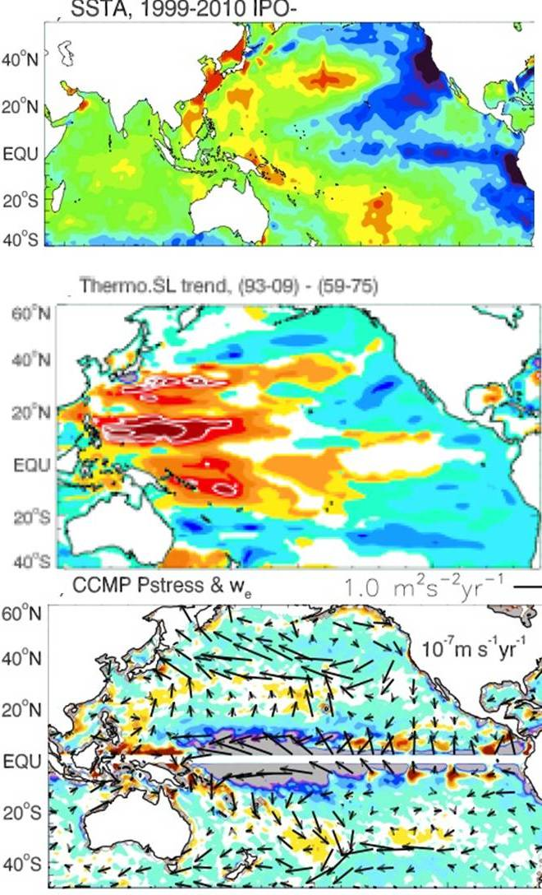
Causes of recent rapid increases of sea level in the tropical western Pacific
Objective
Sea level in the western tropical Pacific has risen more rapidly than in other regions in the past 15 years or so. In that time period there has been a response of the climate system to increasing greenhouse gases as well as significant decadal variability associated with the Interdecadal Pacific Oscillation (IPO). What are the contributions from each to the regional sea level rise?
Top: SST anomaly trend for recent negative IPO phase, 1999-2010;
middle: upper 700m thermosteric sea level difference, 1993-2009 minus 1959-75;
bottom: linear trend of wind
stress (arrows) and Ekman pumping velocity, (colors) 1993-2009; negative IPO (top) is associated with stronger trades and greater upwelling (bottom) that produces greater regional sea level rise in the western tropical Pacific (middle)
Approach
Observations of sea level and surface winds are analyzed to document observed changes
Analyses are performed of an ocean-only model driven by observed winds, an idealized atmosphere-only model run with observed SSTs with a uniform tropical warming and an additional warming added to the tropical Indian Ocean, and GOGA and TOGA runs
Impact
Recent faster sea level rise in the western tropical Pacific is due to a combination of the transition of the IPO from positive to negative in the late 1990s that increased Pacific trade wind strength, and a faster warming of the Indian Ocean during the period that also contributed to stronger trades. More water piled up faster in the western Pacific to produce rapid increases of sea level there.
Han, W., G.A. Meehl, A. Hu, M.A. Alexander , T. Yamagata, D. Yuan, M. Ishii, P. Pegion, J. Zheng, B.D. Hamlington, X.-W. Quan, and R.R. Leben, 2013: Intensification of decadal and multi-decadal sea level variability in the western tropical Pacific during recent decades. Clim. Dyn., doi:10.1007/s00382-013-1951-1.

