Slide 1
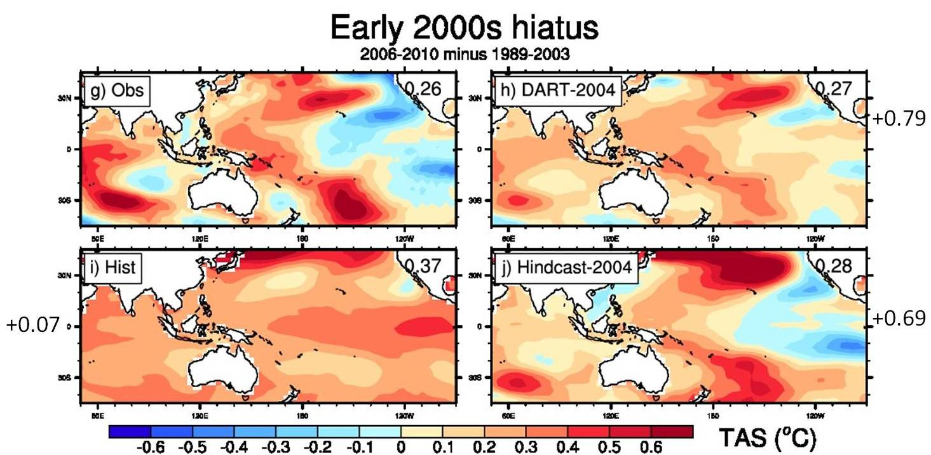
Case studies for initialized decadal hindcasts and
predictions for the Pacific region
Objective
Determine whether previously observed major climate shifts can be simulated by initialized retrospective predictions (or hindcasts) of these past conditions. If they can, this builds credibility for the skill and usefulness of initialized decadal climate predictions for future near-term climate.
Initialized simulations (right panels, 5 year averages, predictions for years 3-7) better simulate the observed early-2000s hiatus (upper left) compared to a free-running simulation (lower left); correlation skill next to panels, larger correlations indicate better skill
Approach
Case studies are analyzed for the mid-1970s climate shift, when the eastern tropical Pacific warmed over a decade and globally averaged temperature rapidly increased, and the early 2000s hiatus when the eastern tropical Pacific cooled over a decade and global temperatures warmed little.
Two different initialization techniques are used in a global coupled climate model, the CCSM4.
Impact
There is additional skill in the initialized hindcasts for surface temperature patterns for the Pacific region over and above that in free-running historical simulations with the same model, and about 20% less global warming predicted for near-term climate change than in a free-running projection
Meehl, G.A., and H. Teng, 2012: Case studies for initialized decadal hindcasts and predictions for the Pacific region. Geophys. Res. Lett., doi:10.1029/2012GL053423

